Slide 1
Towards improved experimental design of E&R studies
Christian Schlötterer

Slide 2
Increase power to detect selected loci
Software tools
Laboratory natural selection vs. truncating selection
Reference population: outbred base population vs. reconstituted base population
Trait architectures: QTL vs. Darwinian selection with constant s

Slide 3
Towards experimental guidelines
Increasing the power to detect selected loci
Population size
Number of starting chromosomes
Selection coefficient
Number of replicates
Duration of experiment
Number of selected loci
Trait architecture
Linkage disequilibrium in the founder population
Starting frequency of selected site

Slide 4
Increasing the power to detect selected loci
Comparison of endpoints

Slide 5
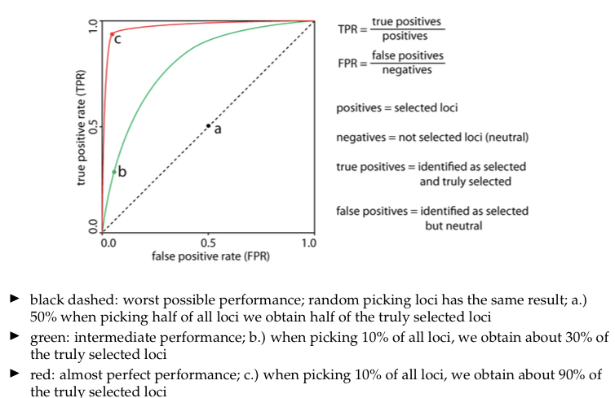
How to measure performance?

Slide 6
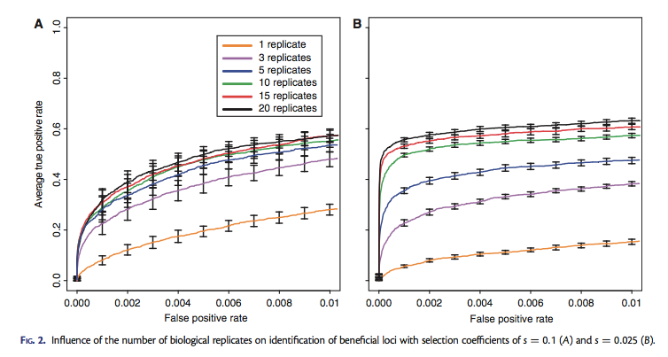
Number of replicates
Kofler et al, 2014

Slide 7
Number of replicates
Burke et al, 2014

Slide 8
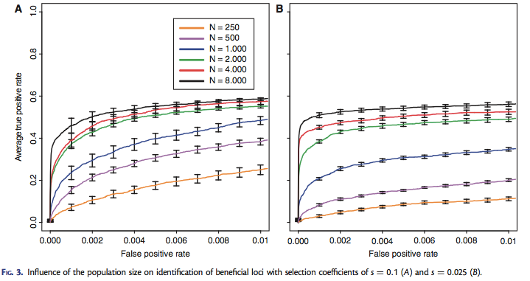
Population size
Kofler et al, 2014

Slide 9
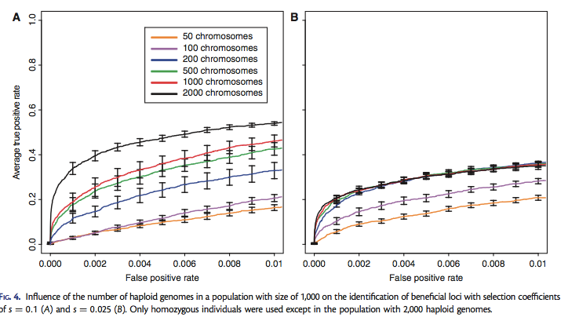
Number of founder haplotypes
Kofler et al, 2014

Slide 10
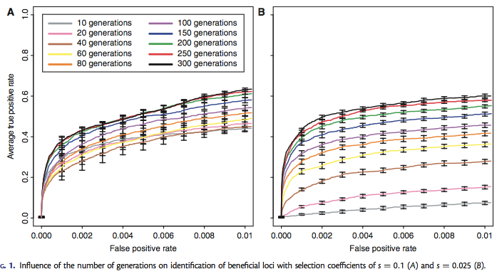
Number of generations
Kofler et al, 2014

Slide 11
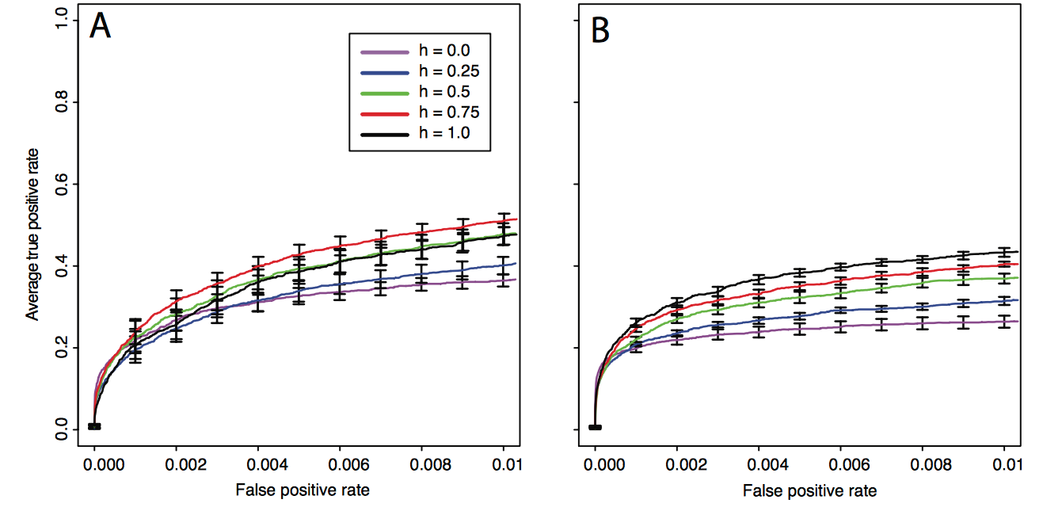
Dominance
s=0.1
s=0.025

Slide 12
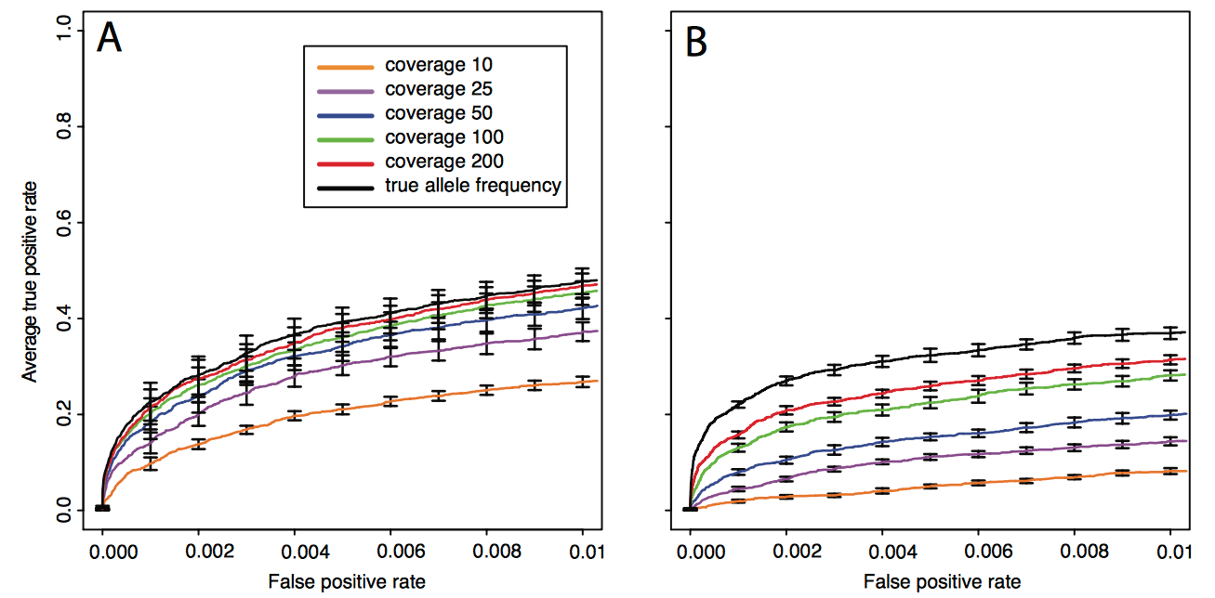
Coverage
s=0.1
s=0.025

Slide 13
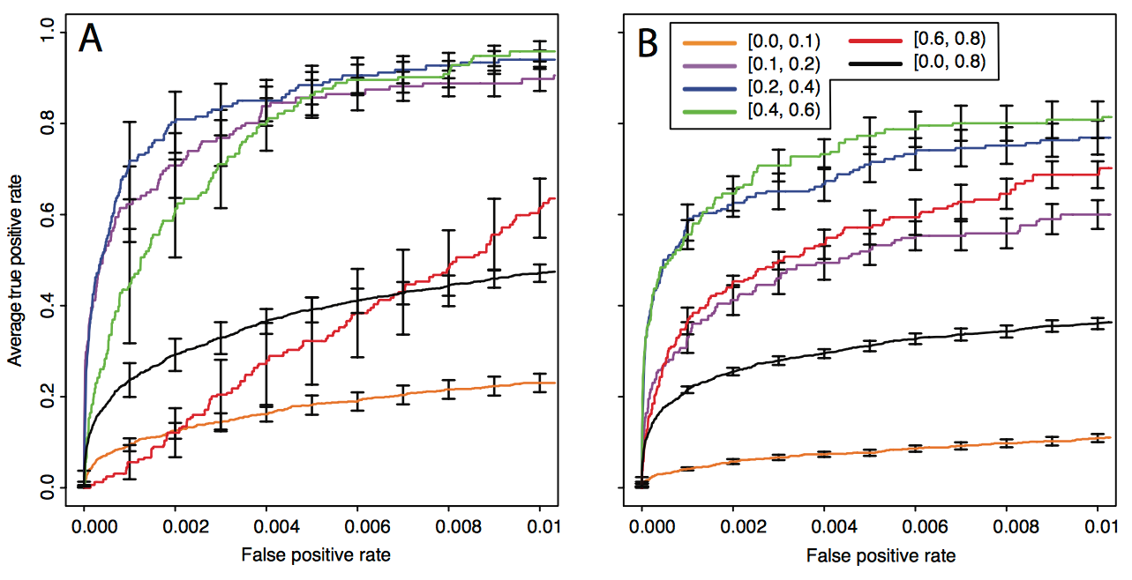
Starting allele frequency

Slide 14
Increasing the power to detect selected loci
Time series data

Slide 15
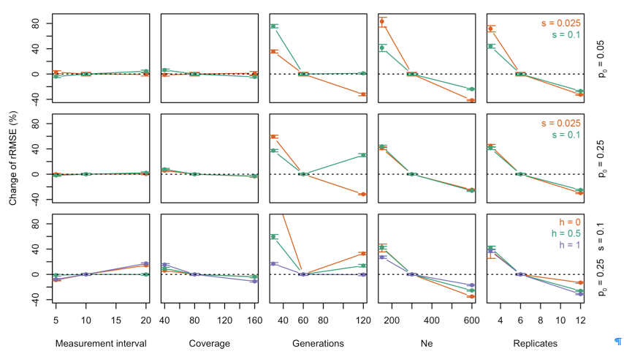
Time series analysis
Taus et al., MBE 2017

Slide 16
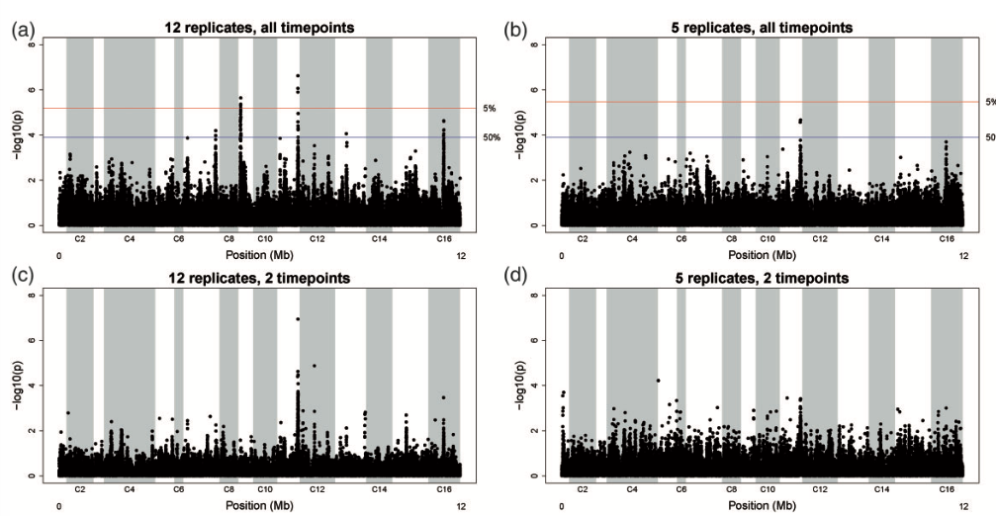
Time series analysis
Burke et al., MBE 2014

Slide 17
Trait architecture

Slide 18
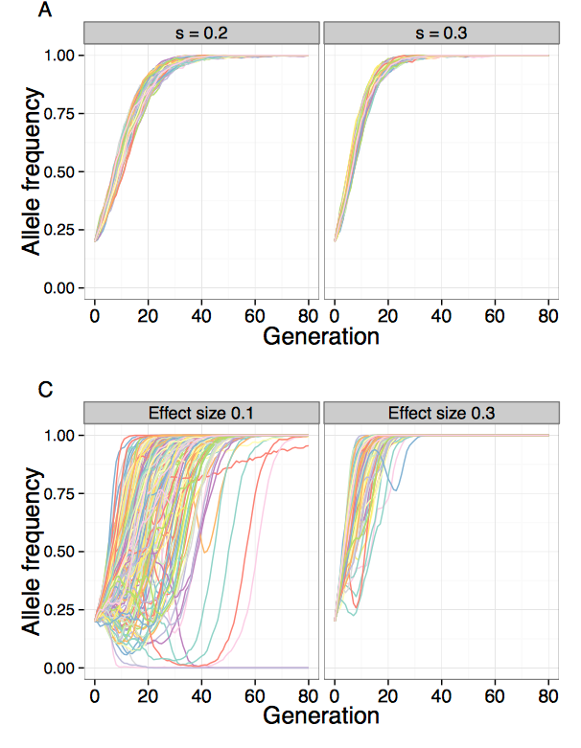
Constant s vs. QTL with truncating selection
Kessner & Novembre Genetics, 2015
Notes:
Qualitative differences between fixed selection coefficient and truncation selection on a quantitative trait. A focal QTL exhibits fundamentally different behavior under a constant selection coefficient, compared to truncation selection on a quantitative trait. Shown are allele frequency trajectories (A) and realized selection coefficient distributions (B) of a locus under two different selection coefficients (0.2, 0.3) (N = 1000, 80 generations) C and D show the same for a focal QTL (effect sizes 0.1, 0.3) under truncation selection on the trait (N = 5000, selected, 80 generations, 100 QTL, , ).
In addition, once an allele with a constant selection coefficient reaches high frequency, it only gradually increases in the final generations before finally going to fixation. In contrast, the focal QTL under truncation selection tended to become fixed quickly after reaching high frequency in the population. This behavior is not surprising, because after a few generations of selection, the upper tail of the population trait value distribution is highly enriched for individuals carrying high-effect variants.

Slide 19
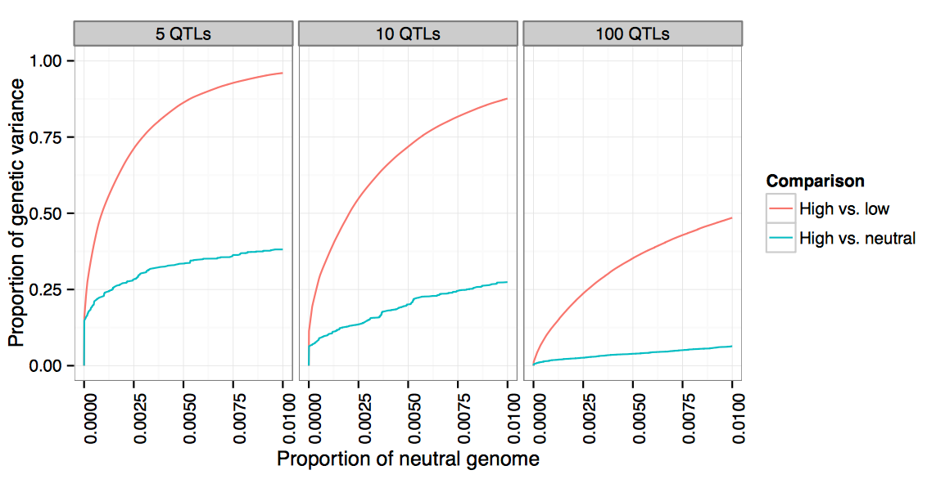
Bi-directional vs. uni-directional selection

Slide 20
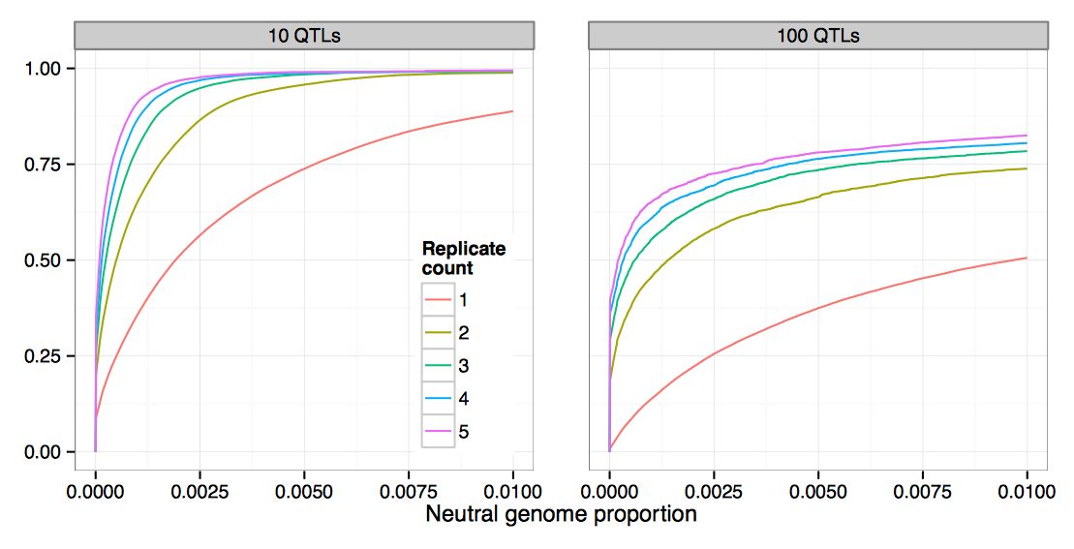
Replication

Slide 21
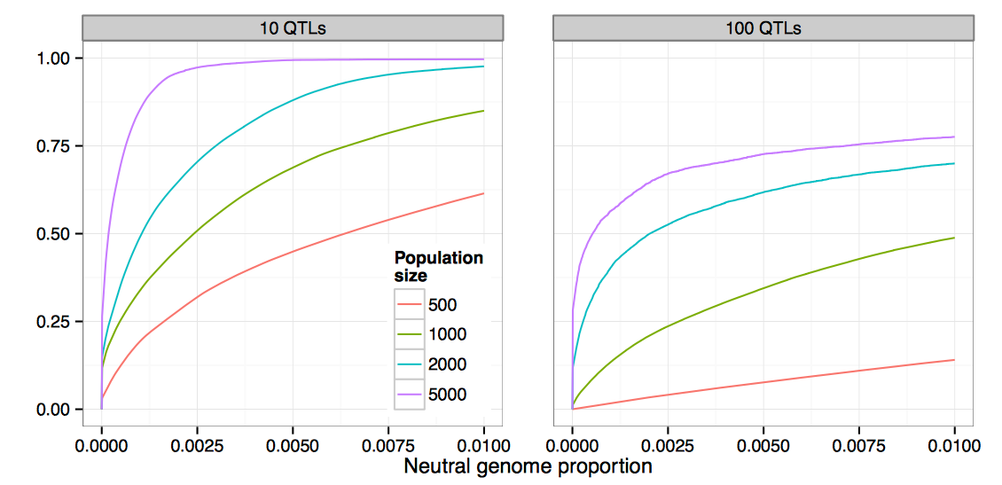
Population size

Slide 22
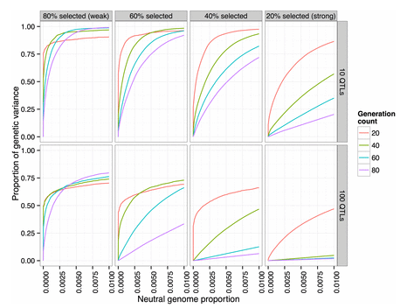
Duration of experiment and selection strength
Notes:
One particularly interesting finding was that under strong selection, power can actually decrease with the number of generations, depending on the false-positive rate threshold chosen (for example, or selected, at false-positive rate 0.01 in Figure 9). In these scenarios, most of the QTL have differentiated by generation 20 (> of the genetic variance was detected at false-positive rate 1%). However, the lower effective population size induced by strong selection results in the fixation of many neutral variants, which are then falsely detected as QTL
Conversely, by lowering the selection pressure ( selected each generation) the maximum power is actually increased. In addition, letting the experiment run for a greater number of generations at this lower selection pressure increases the maximum power attained.
These observations suggest that recombination plays a large role in the power to detect and localize QTL: reducing the selection pressure and increasing the number of generations should allow more recombination, which reduces linkage disequilibrium between QTL and neighboring neutral variants. Increased recombination will also reduce interference between QTL, which should allow lower-effect QTL to be selected and detected. This led us to investigate the effects of recombination further in our subsequent analyses.

Slide 23
Comparison of software/methods

Slide 24
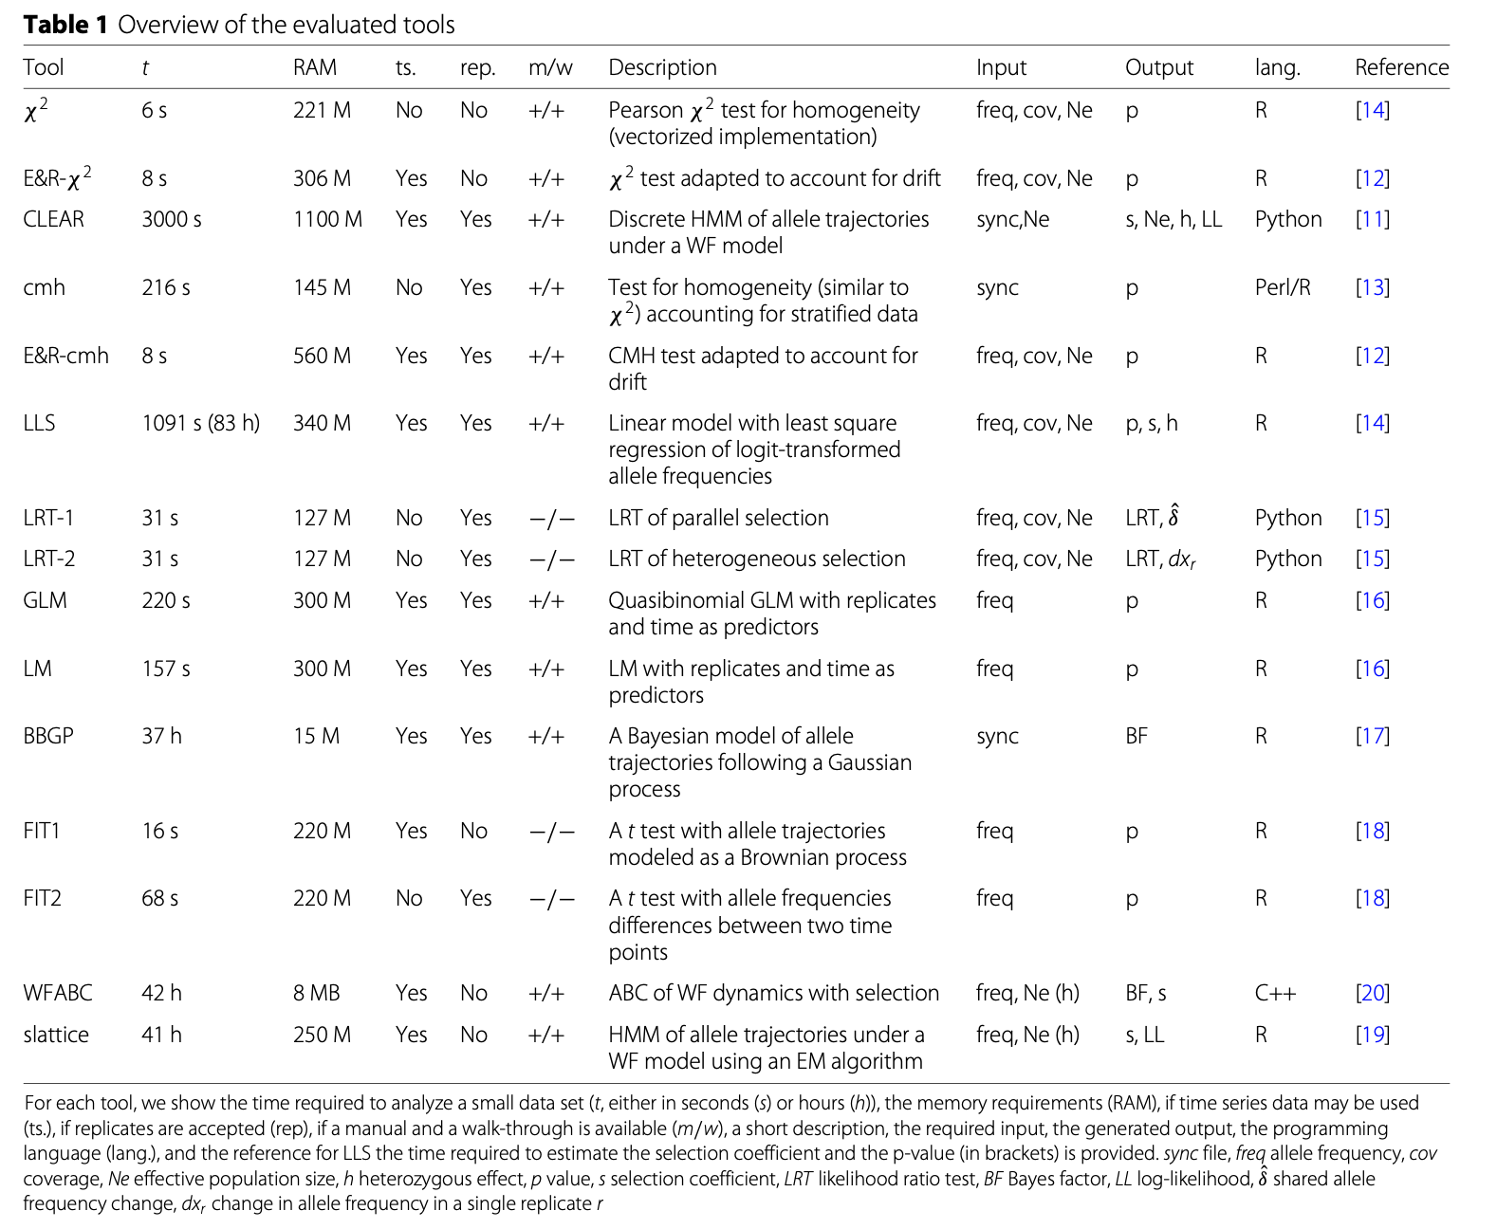
Many different software tools

Slide 25
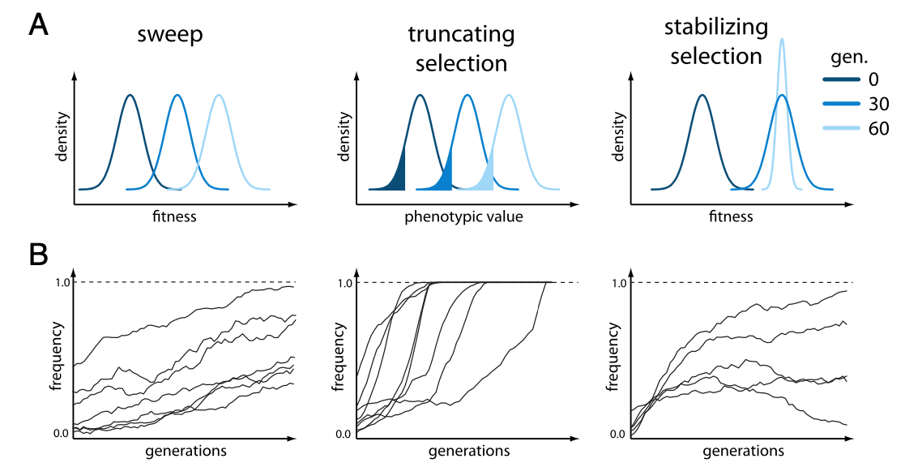
3 different scenarios

Slide 26
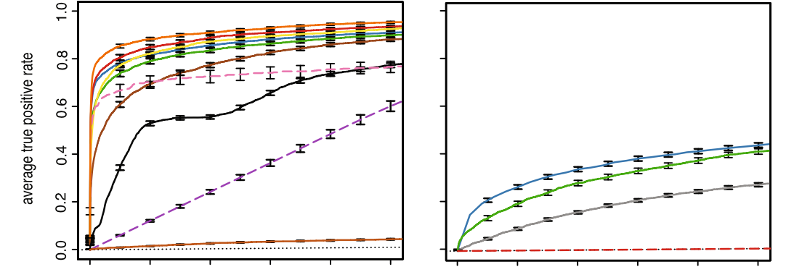
sweeps
Vlachos et al. 2019

Slide 27
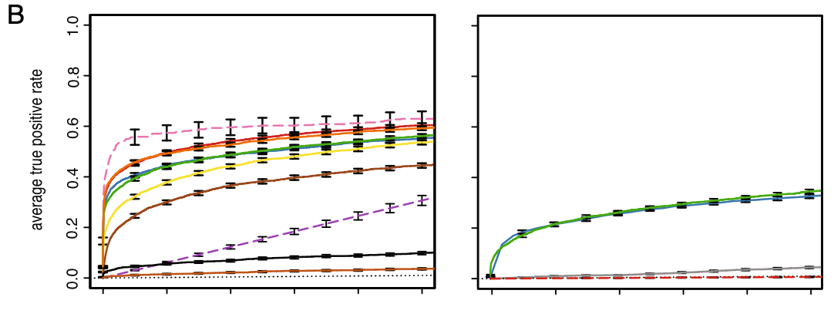
Truncating selection

Slide 28
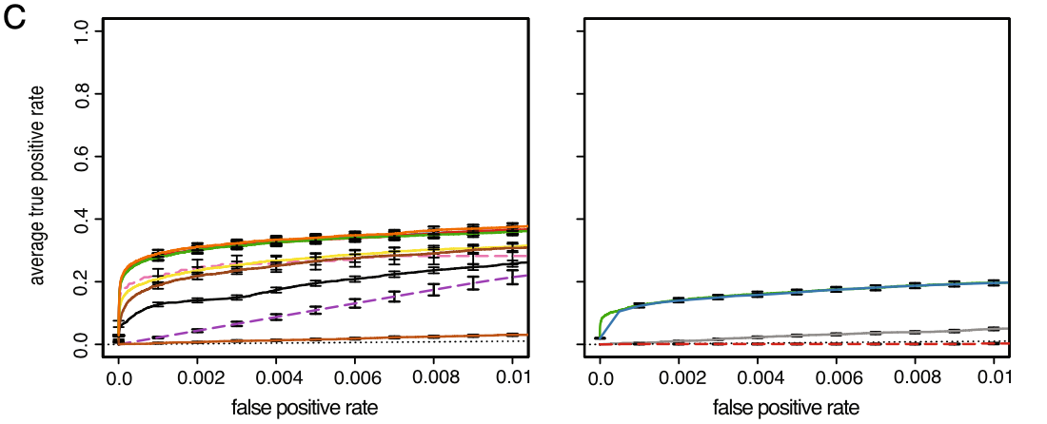
Stabilizing selection

Slide 29
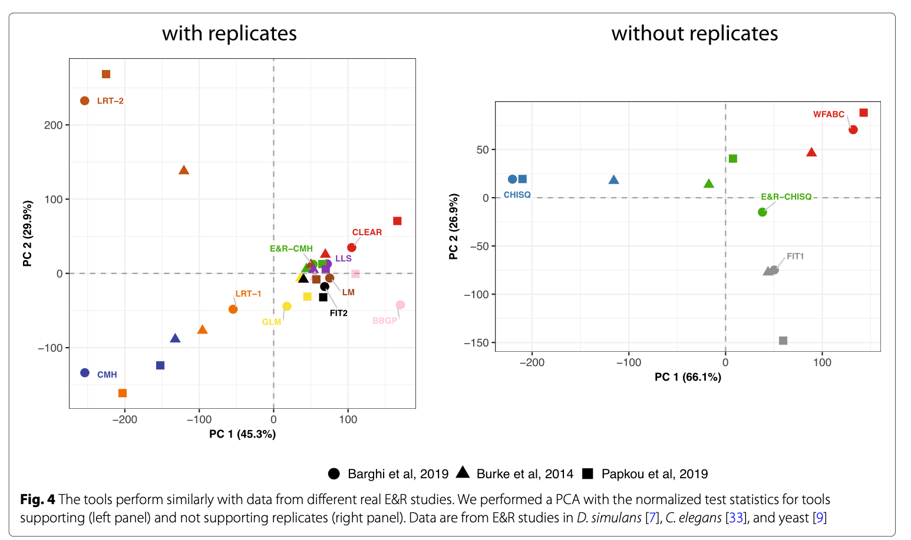
Similar performance on different real data sets
Vlachos et al. 2019

Slide 30
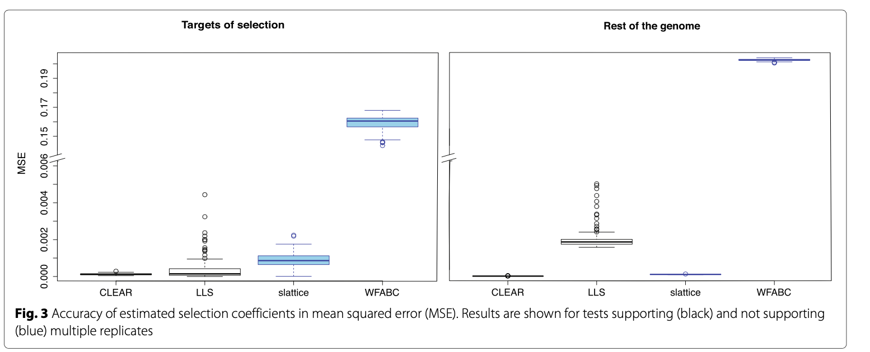
Estimating s
Vlachos et al. 2019

Slide 31
Laboratory natural selection vs. truncating selection

Slide 32
Laboratory natural selection vs. truncating selection
Truncating selection
Trait is known
Selection strength is arbitrary
For QTLs trait no trait optimum exists → relevance to natural conditions?
Laboratory natural selection
Selected traits are not known
Matches closely natural conditions
Better suited to study QTLs

Slide 33
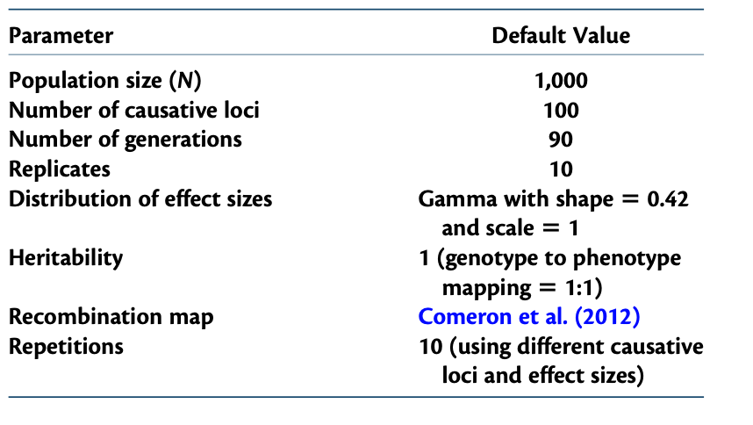
A new experimental design
Vlachos & Kofler 2019

Slide 34
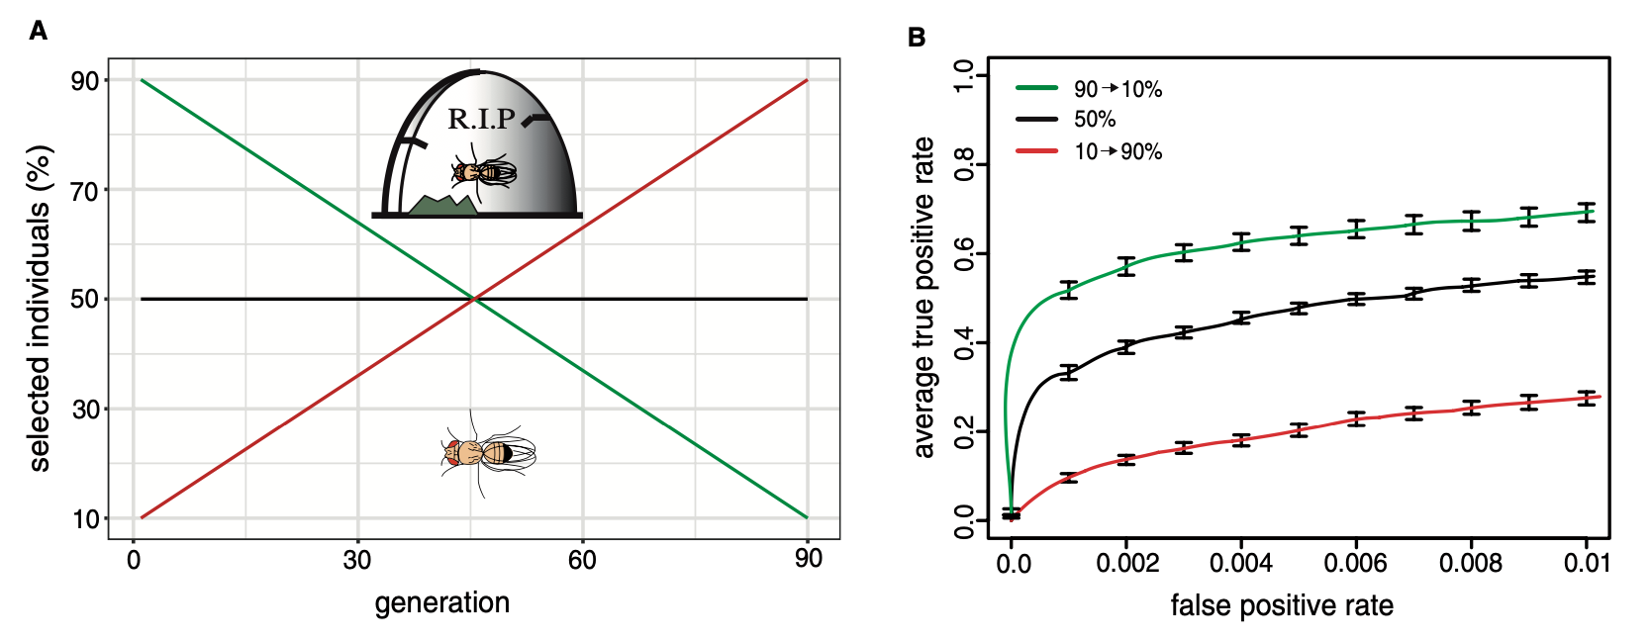
A new experimental design
Vlachos & Kofler 2019

Slide 35
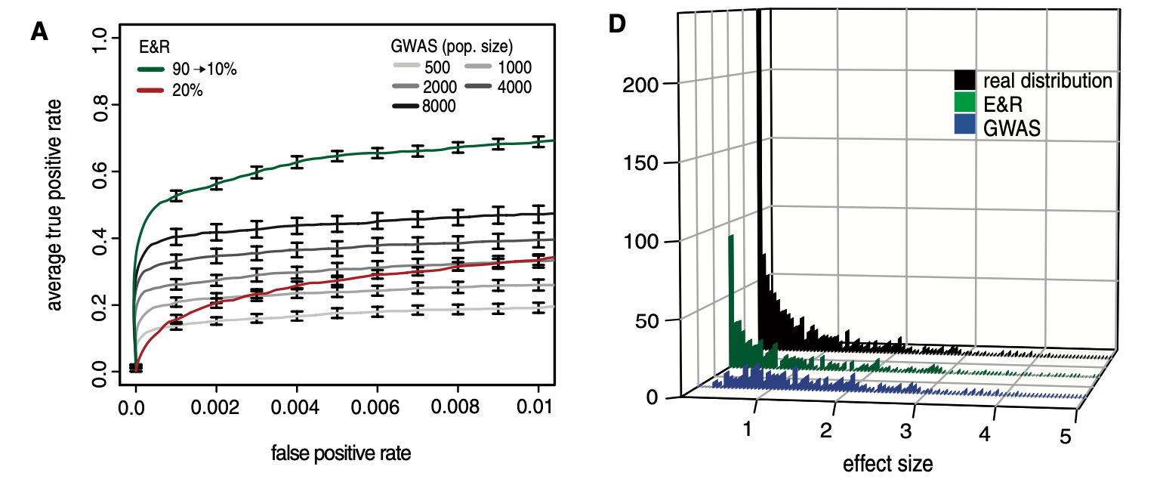
Comparison to GWAS
Vlachos & Kofler 2019

Slide 36
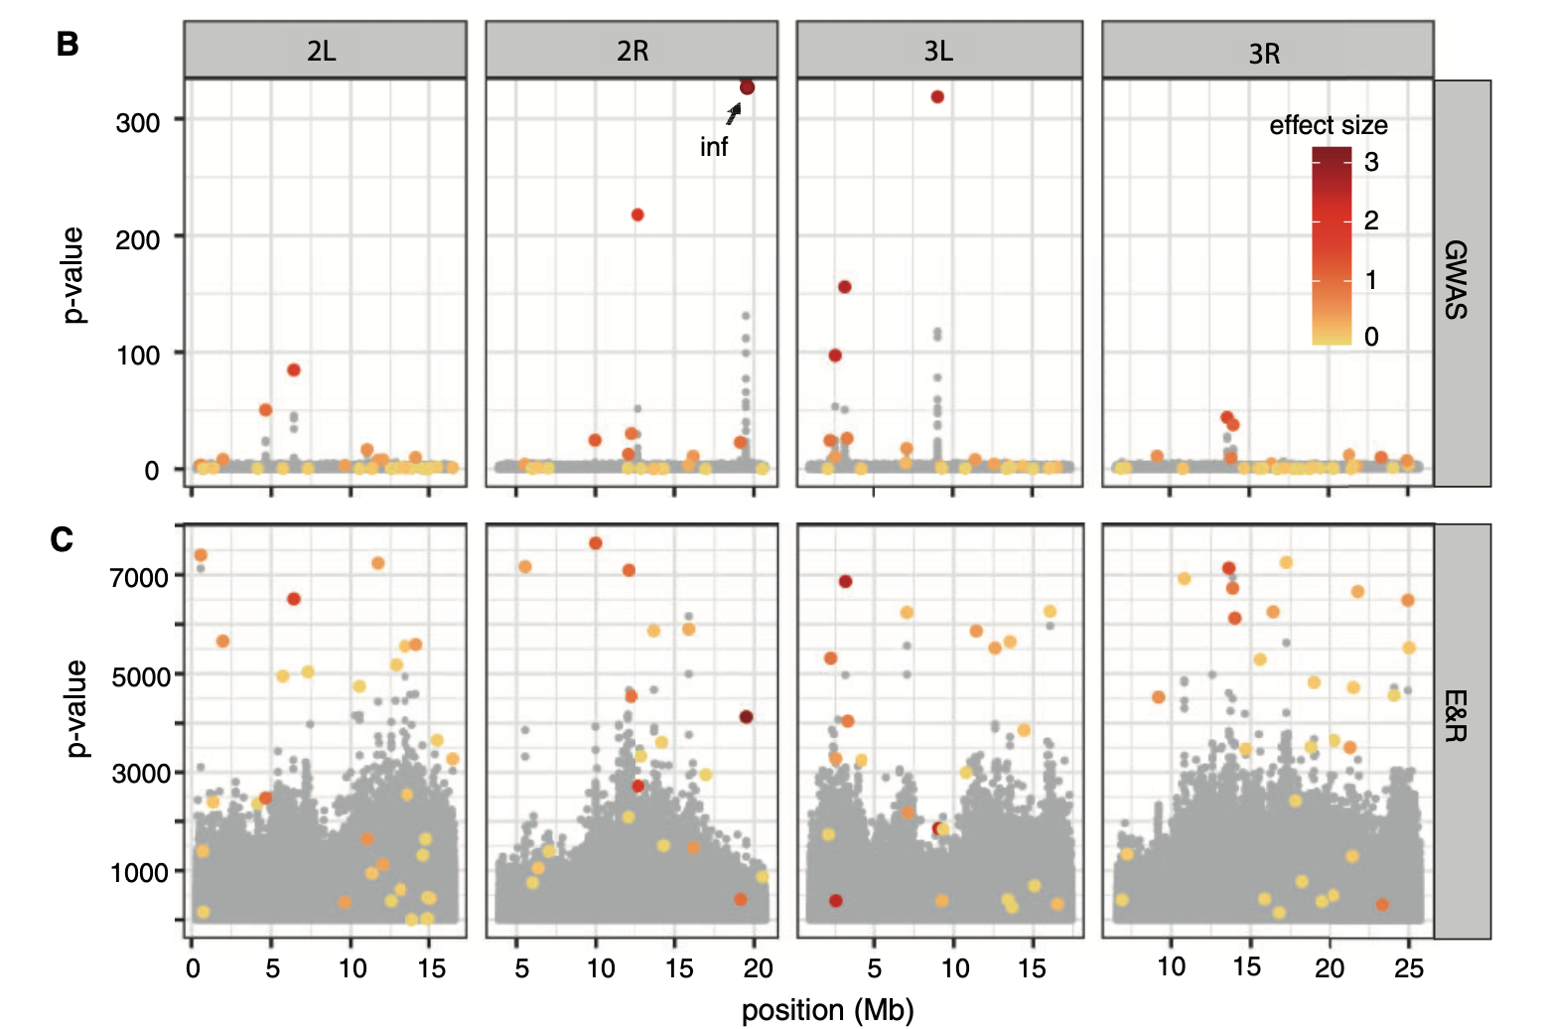
Comparison to GWAS
Vlachos & Kofler 2019

Slide 37
Reference population

Slide 38
Outbred base vs. reconstituted base
Outbred, lab adapted
Pro:
lab adaptation is no longer an issue
High diversity maintained
Readily available
Con:
Linkage disequilibrium
Fixation of deleterious mutations by drift?
Contamination?

Slide 39
Outbred base vs. reconstituted base
Reconstituted
Pro:
No drift
Selection is minimized due the small population size in isofemale lines
High diversity maintained
Reconstituting is laborious
Con:
Populations will not be adapted to laboratory
Maintenance is more effort when the number of isofemale lines is high
Segregating variation in isofemale lines

Slide 40
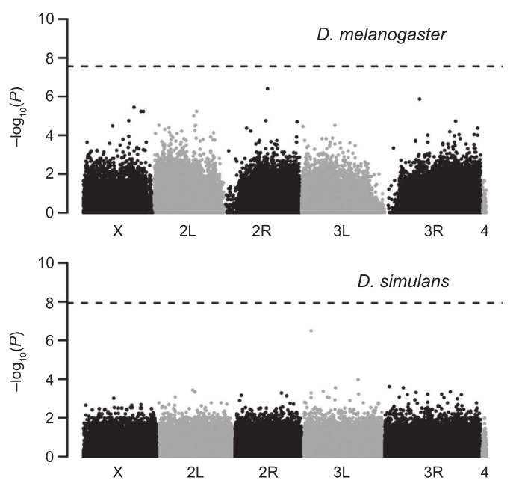
Outbred base vs. reconstituted base

Slide 41
Time series allows the distinction between sweep loci and quantitative traits
Quantitative trait loci
Franssen et al. Heredity 2017

