Slide 1


Quantum Error Correction for unresolvable spin ensembles
Harsh Sharma
Department of Physics, IIT Bombay
(harsh.sharma@iitb.ac.in)
Quantum Trajectories
23 January 2025

Slide 2
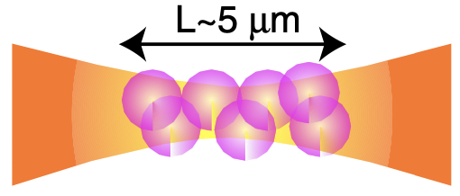



Spin Ensembles
$$γ_{d}$$
$$Γ_{m}$$
Applications
Readout
Ancilla
Quantum Computing & Communications
Quantum Simulations
Quantum Metrology
Control
$$γ_{m}$$
Atoms
Decoherences
Solid state spins
Trapped Ions
Quantum Error Correction!
Defect centers
E. Brion et. al., Phys. Rev. Lett. 99, 260501, (2007).

Slide 3
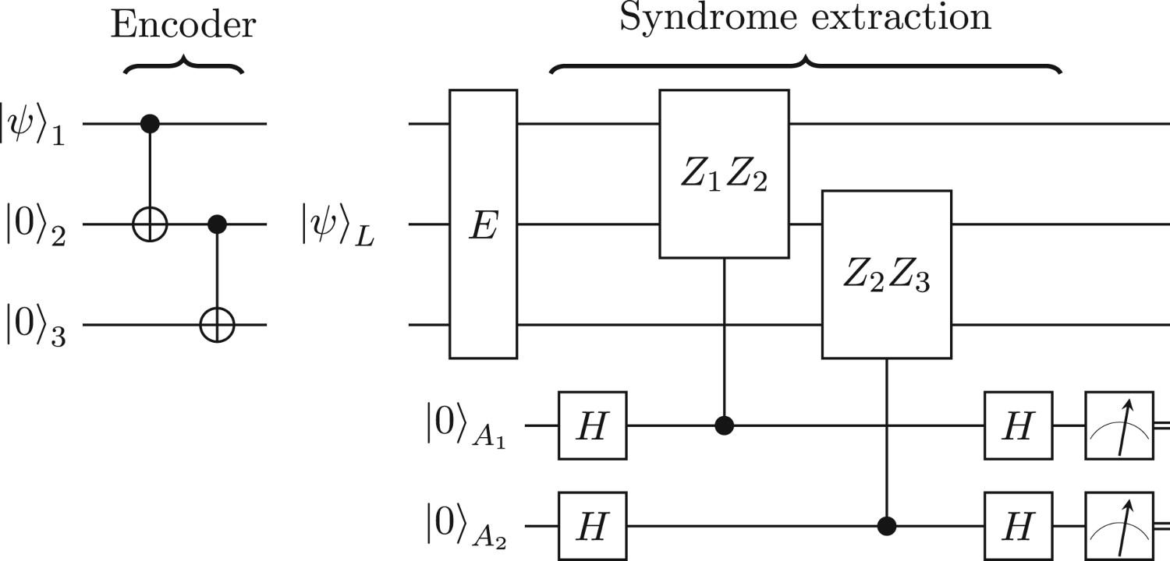







Quantum Error Correction
3-Qubit repetition code for bit-flip errors:
J. Roffe, Contemporary Physics, 60:3, 226–245 (2019).
$$Z_{1}Z_{2}E{\left|ψ\right\rangle }_{L}=(+1)E{\left|ψ\right\rangle }_{L}$$
$$Z_{2}Z_{3}E{\left|ψ\right\rangle }_{L}=(−1)E{\left|ψ\right\rangle }_{L}$$
Redundancy is introduced through larger Hilbert spaces.
$${\left|0\right\rangle }_{A_{1}}$$
$${\left|ψ\right\rangle }_{L}=α \left|000\right\rangle +β |111⟩$$
$${\left|1\right\rangle }_{A_{1}}$$
$${\left|ψ\right\rangle }_{L}⊥E{\left|ψ\right\rangle }_{L}$$
$${E\left|ψ\right\rangle }_{L}=α \left|001\right\rangle +β |110⟩$$
Doesn’t work for unresolvable qubits!

Slide 4


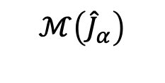
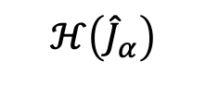

Can one perform QEC without individual spin resolution?
$$Γ_{m}$$
Readout
$$γ_{d}$$
$$ℳ\left({\hat{J}}_{α}\right)$$
Control
$$ℋ\left({\hat{J}}_{α}\right)$$
$$γ_{m}$$
H. Sharma, H. S. Dhar, and H.-K. Lau. arXiv:2408.11628 (2024).

Slide 5
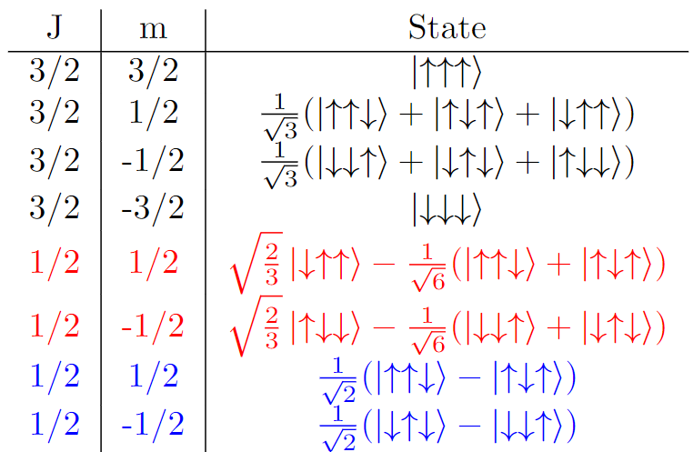
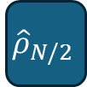





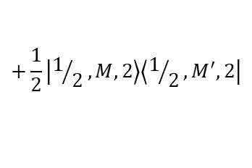




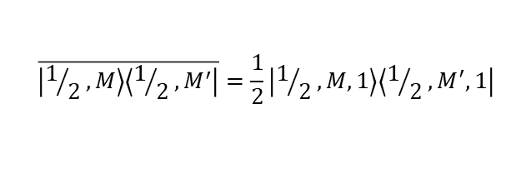





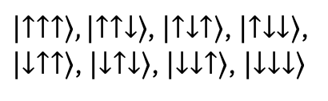

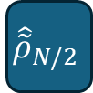

Permutationally Invariant States
Computational Basis
Angular Momentum Basis
PI Basis
For 3 spins:
$$ℂ^{2}⊗ℂ^{2}⊗ℂ^{2}$$
$$ℂ^{4}⊕(ℂ^{2}⊗ℂ^{2})$$
$$ℂ^{4}⊕ℂ^{2}$$
M
$\left|↑↑↑\right\rangle ,\left|↑↑↓\right\rangle$, $\left|↑↓↑\right\rangle$, $\left|↑↓↓\right\rangle$,
$\left|↓↑↑\right\rangle$, $\left|↓↑↓\right\rangle$, $\left|↓↓↑\right\rangle$, $\left|↓↓↓\right\rangle$
$$\overline{\left|3/2,M\right\rangle \left\langle 3/2,M^{′}\right|}=\left|3/2,M,1\right\rangle \left\langle 3/2,M^{′},1\right|$$
$$i=1$$
$$\overline{\left|1/2,M\right\rangle \left\langle 1/2,M^{′}\right|}=\frac{1}{2}\left|1/2,M,1\right\rangle \left\langle 1/2,M^{′},1\right|$$
$$+\frac{1}{2}\left|1/2,M,2\right\rangle \left\langle 1/2,M^{′},2\right|$$
$$i=1$$
B A Chase et. al., Phys. Rev. A 78,052101 (2008).
$$i=2$$
T. Moroder et. al., New J. Phys. 14,105001 (2012).
Dicke States
$$|\text{J},M,i⟩$$
Existing PI-QEC
$$\overline{\left|\text{J},M\right\rangle \left\langle \text{J},M^{′}\right|}$$
$${\hat{ρ}}_{N}$$
$${\hat{ρ}}_{N/2}$$
$${\hat{\tilde{ρ}}}_{N/2}$$
PI
Mixed!
$${\hat{ρ}}_{J}$$
$${\hat{\tilde{ρ}}}_{J}$$
Our proposal
$${\hat{ρ}′}_{J}$$
No coherences b/w blocks
$${\hat{ρ}}_{0}$$
$${\hat{ρ}}_{J}={\hat{ρ}′}_{J}$$
$${\hat{\tilde{ρ}}}_{0}$$

Slide 6


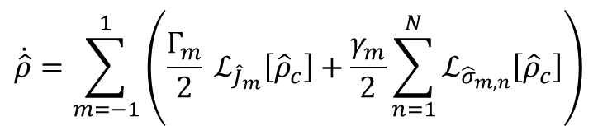
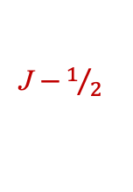
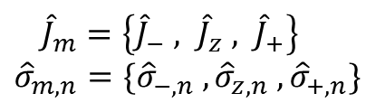
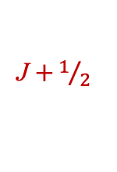

System dynamics and error processes
$$γ_{d}$$
$$Γ_{m}$$
$$\dot{\hat{ρ}}=\sum_{m=−1}^{1}{\left(\frac{Γ_{m}}{2} ℒ_{{\hat{J}}_{m}}\left[{\hat{ρ}}_{c}\right]+\frac{γ_{m}}{2}\sum_{n=1}^{N}{ℒ_{{\hat{σ}}_{m,n}}\left[{\hat{ρ}}_{c}\right]}\right)}$$
Lindblad Master Equation:
${\hat{J}}_{m}=\left\{{\hat{J}}_{−} , {\hat{J}}_{z} , {\hat{J}}_{+}\right\}$
${\hat{σ}}_{m,n}=\{{\hat{σ}}_{−,n} , {\hat{σ}}_{z,n} , {\hat{σ}}_{+,n}\}$
$$γ_{m}$$
M
M + 3
M + 2
Errors in ensembles:
M + 1
Collective:
Decay
Dephasing
Pumping
M
Local:
Decay
Dephasing
Pumping
M - 1
Spin Loss
M - 2
M - 3
J
J + 1
J $+1/2$
J
J $−1/2$
J - 1
N. Shammah et. al., Phys. Rev. A 98, 063815 (2018).

Slide 7
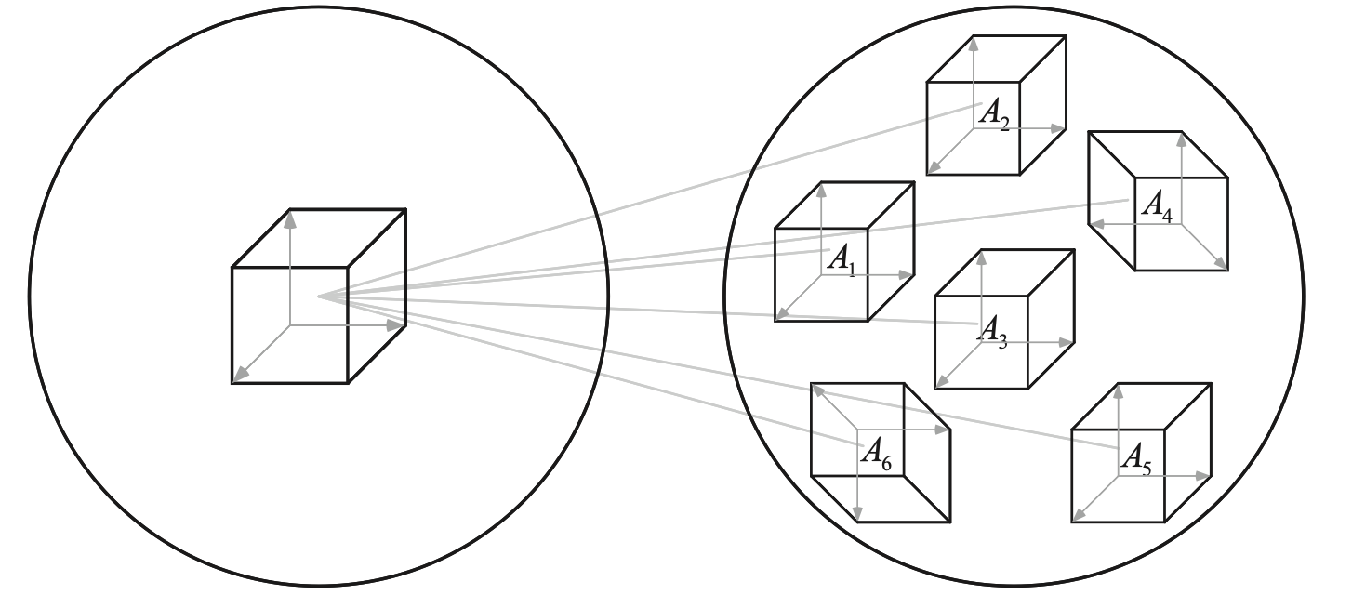




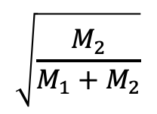

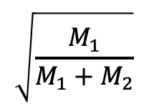



Correcting Errors
Knill-Laflamme conditions:
.
.
Errors map encoded states to orthogonal subspaces.
$$\left|ψ_{Q}\right\rangle =α_{0} \left|0\right\rangle +α_{1} |1⟩$$
$$M_{1}$$
$$J_{th}=M_{1}$$
Both logical qubits have same decoherence rates for any given error.
$$|1⟩$$
$$M_{2}$$
Encoding
$$|0⟩$$
$${−M}_{2}$$
$$\sqrt{\frac{M_{1}}{M_{1}+M_{2}}}$$
$$\sqrt{\frac{M_{2}}{M_{1}+M_{2}}}$$
$${−M}_{1}$$
.
.
J
M. A. Nielsen and I. L. Chuang, Quantum Computation and Quantum Information, 2010.
H. Sharma, H. S. Dhar, and H.-K. Lau. arXiv:2408.11628 (2024).

Slide 8
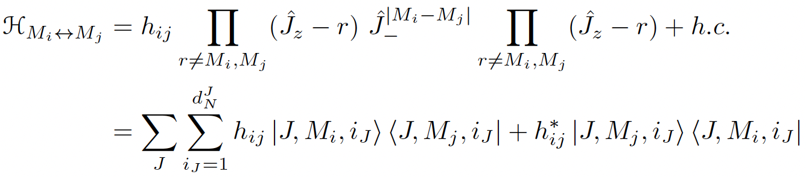




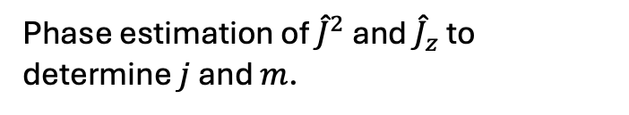









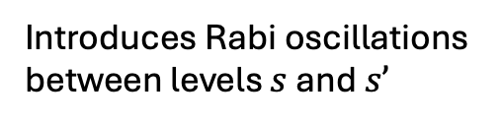













QEC Protocol
$$α_{0}$$
$ℒ_{\hat{A}}(ρ)$
$$α_{0}$$
$${\hat{ρ}}_{Q}$$
Encoding
$${\hat{ρ}}_{L}$$
$${\hat{ρ}}_{C}$$
$${\hat{ρ}}_{C}′$$
$${\hat{ρ}}_{L}′$$
Decoding
$${\hat{ρ}}_{Q}$$
$$α_{1}$$
.
.
$$α_{1}$$
.
.
Syndrome Measurement
$$γ_{−1}$$
Phase estimation of ${\hat{J}}^{2}$ and ${\hat{J}}_{z}$ to determine $j$ and $m$.
$$M_{1}$$
$$M_{1}$$
$$U_{1}$$
$$|1⟩$$
$$M_{2}$$
$$M_{2}$$
Y. Wang et. al., Phys. Rev. A 104, 032407 (2021).
$$U_{1}$$
Individual Decay
Recovery Process
$$U_{2}$$
$$|0⟩$$
$${−M}_{2}$$
$${−M}_{2}$$
$$U_{1}$$
$${−M}_{1}$$
$${−M}_{1}$$
$$U_{1}$$
.
.
.
.
Introduces Rabi oscillations between levels $s$ and $s’$
J
J$−1$
N. Gutman et. al., Phys. Rev. Lett. 132, 153601 (2024).

Slide 9
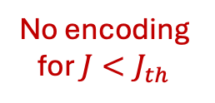


















Simulations
Teleportation based Extraction
$$m=−1$$
Correction
$$\text{J}>{\text{J}}_{th}$$
$$\left|ψ_{Q}\right\rangle$$
Error
Detection
$$\text{J}={\text{J}}_{th}$$
$${ X}_{Q}$$
$${\hat{J}}_{z}$$
$$|+_{Q}⟩$$
$${ X}_{Q}$$
Teleportation
by-product correction
$$\left|ψ_{Q}\right\rangle$$
$$M_{1}$$
5
$$\left|+_{A}\right\rangle$$
$${ \hat{σ}}_{z}$$
Encoded
$$M_{2}$$
2
More # Excitation
$$M_{1}$$
-2
$${−M}_{2}$$
Multiple rounds of decay
+ QEC
$$M_{2}$$
No encoding for $J<J_{th}$
$$m=0,±1$$
-5
$${−M}_{1}$$
$${−M}_{2}$$
Unencoded
Less # Excitation
-9
$$10$$
-10
$${−M}_{1}$$
N=20, J=10
N=20, J_{th}=5

Slide 10
Summary
Scheme to conduct QEC for spin ensemble systems that cannot be resolved.
Represent the logical information as a superposition of PI states that are generally mixed.
PI-QEC protect against all prominent errors in spin ensemble.
Recovery processes of our scheme do not require resolving any subset of the spin.
Our formalism can also develop codes to protect quantum sensing against errors.

Slide 11
Thank You!
Acknowledgements
1. Himadri Shekhar Dhar, Department of Physics, IIT Bombay.
2. Hoi-Kwan (Kero) Lau, Department of Physics, SFU Burnaby.

Slide 12




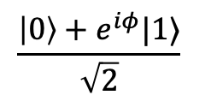

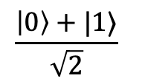
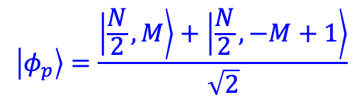
Error protected quantum sensing
$$\frac{\left|0\right\rangle +|1⟩}{\sqrt{2}}$$
$$H_{sig}=ω{\hat{J}}_{z}$$
$$\frac{\left|0\right\rangle +e^{iφ}|1⟩}{\sqrt{2}}$$
Ramsey Interferometry:
$$φ=ωt \left(\left\langle 0\left|{\hat{J}}_{z}\right|0\right\rangle −\left\langle 1\left|{\hat{J}}_{z}\right|1\right\rangle \right)$$
V. Giovannetti et. al., Phys. Rev. Lett. 96, 010401, (2006).
Phase accumulation requires different no. of excitation in $\left|0\right\rangle$ and $|1⟩$ states.
For spontaneous emission:
KL conditions require same decoherence rates of $\left|0_{L}\right\rangle$ and $|1_{L}⟩$ states.
(individual decay process)
$⟹$ Equal excitations in $\left|0_{L}\right\rangle$ and $|1_{L}⟩$
$⟹$No QECC can protect sensing!
For collective decay:
Superradiance changes decoherence rates
$$\left\langle 0_{L}\left|{\hat{J}}_{z}^{2}−{\hat{J}}_{z}\right|0_{L}\right\rangle =\left\langle 1_{L}\left|{\hat{J}}_{z}^{2}−{\hat{J}}_{z}\right|1_{L}\right\rangle$$
Encoding for sensing:
$$\left|φ_{p}\right\rangle =\frac{\left|\frac{N}{2},M\right\rangle +\left|\frac{N}{2},−M+1\right\rangle }{\sqrt{2}}$$

