Slide 1
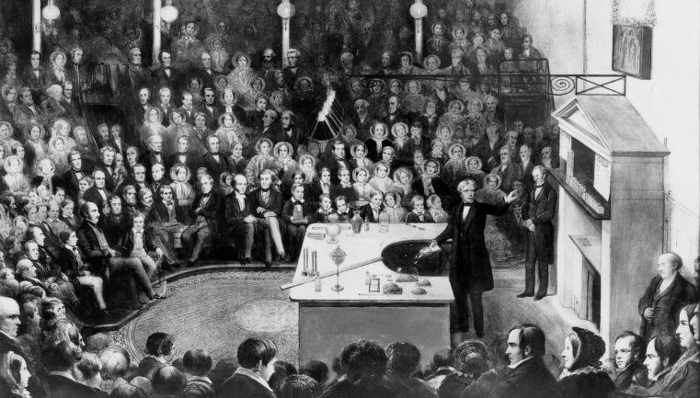

Slide 2
arXiv:2307.14756,
Proceedings of the National Academy of Sciences 121, e2314846121 (2024)

Slide 3
Outline
Description of states of radiation of a transmission line
Concerns microwave quantum technology -- example
Relevance of pure states – multimode coherent states
Nontrivial relation between the classical description & the photonic content for short pulses
Gedanken application: ultra high rate QKD in microwave setting
New concept for measurement of ultra-short photonic pulses

Slide 4
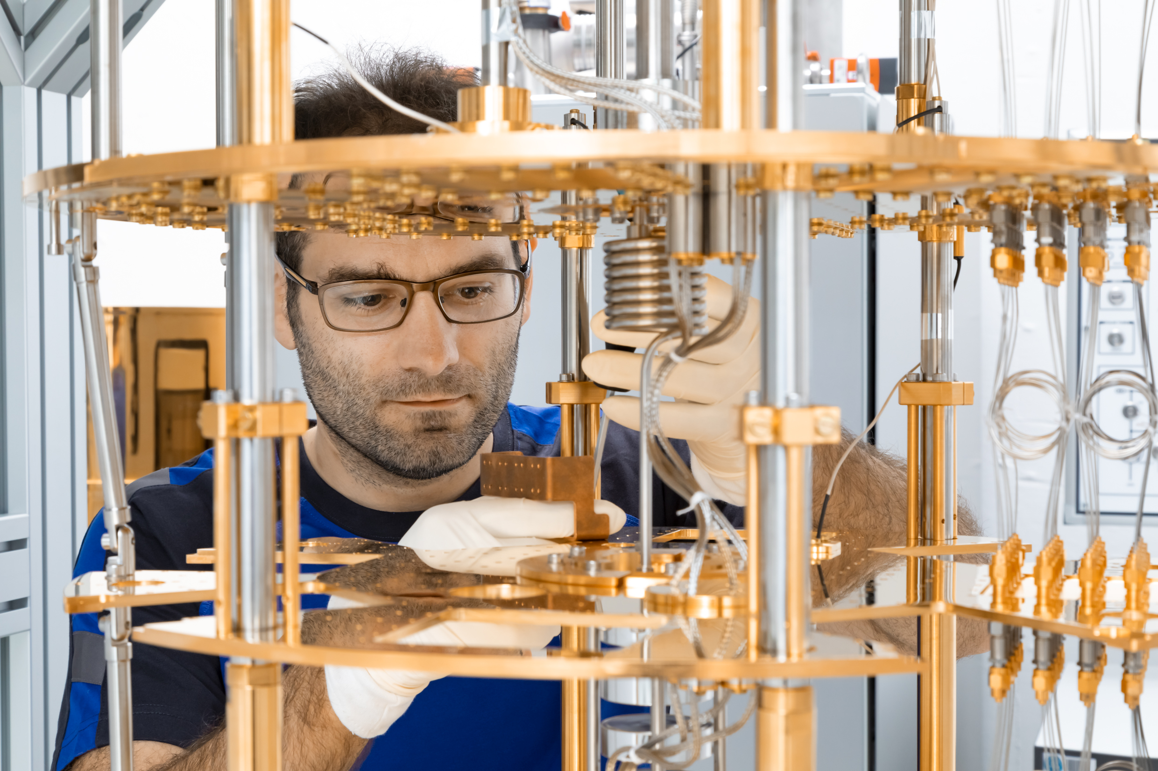
Markus Jerger, Institute for Functional Quantum Systems, Jülich
“arbitrary waveform generator”

Slide 6
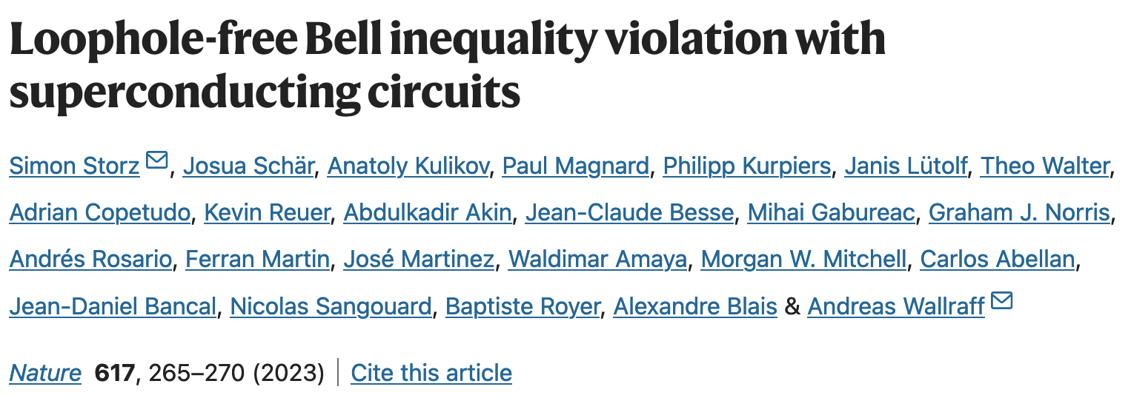
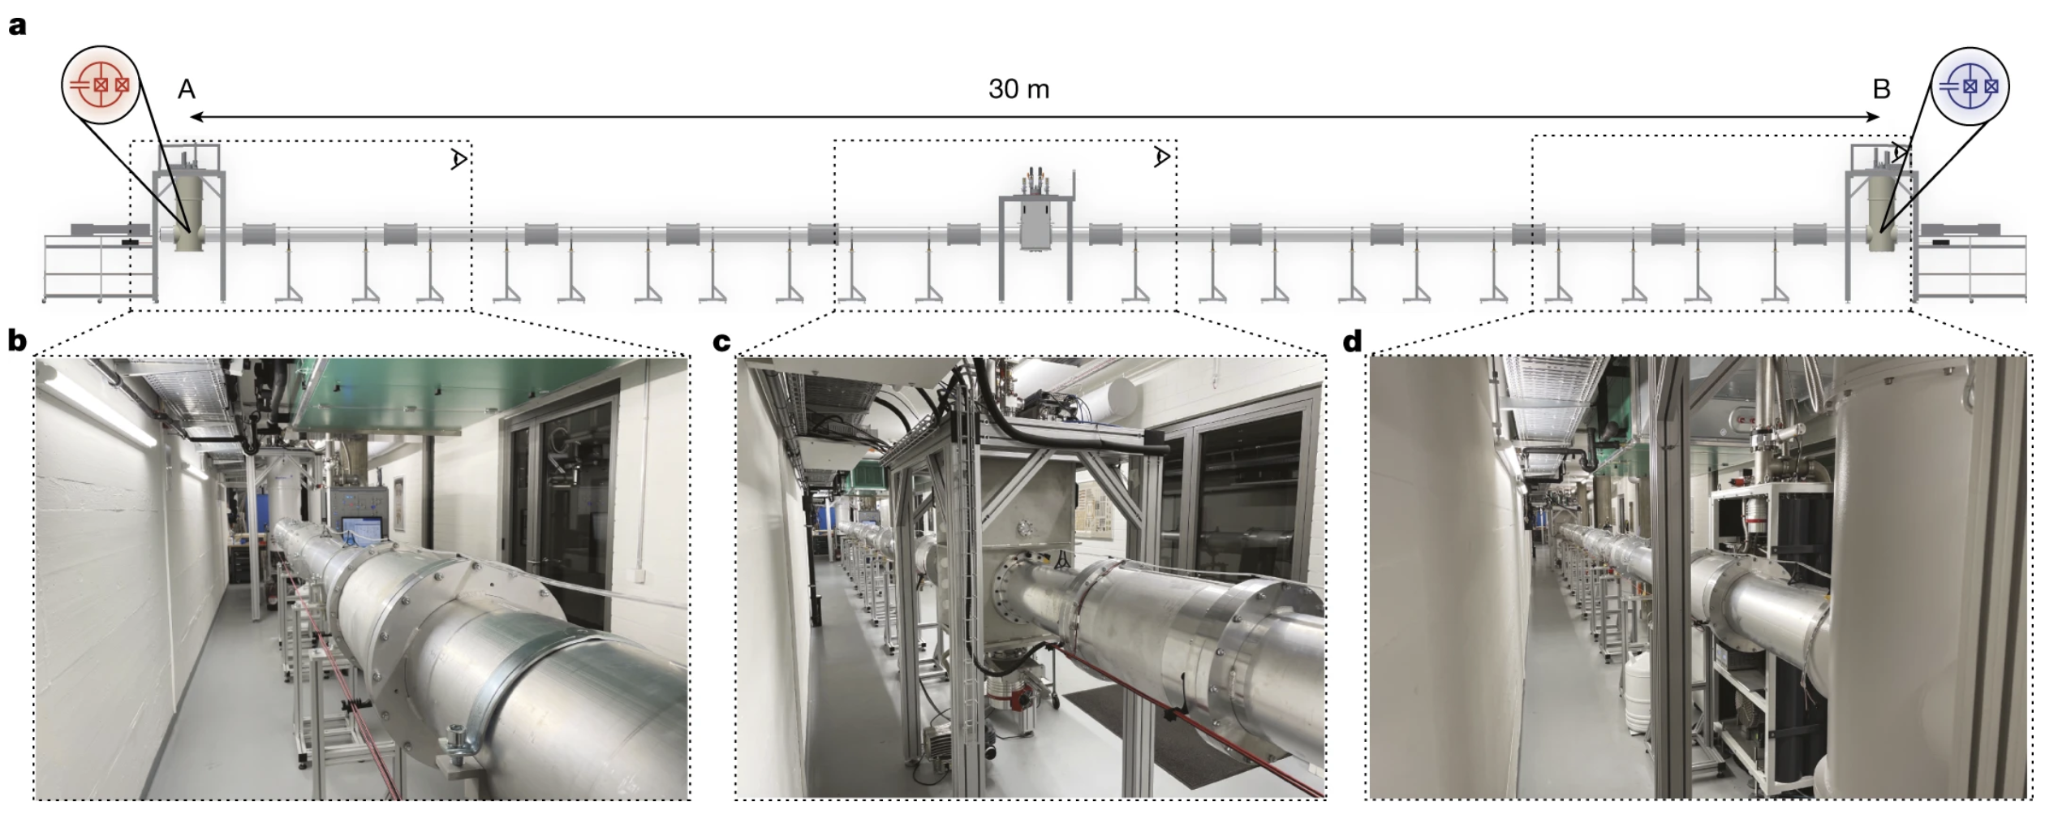

Slide 7
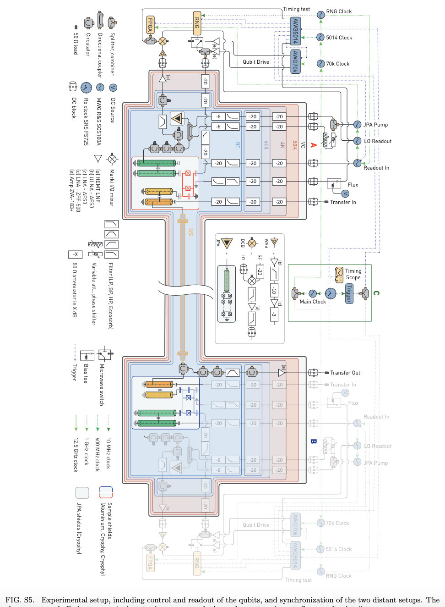

Slide 11
c = Capacitance per unit length = C₀/dx
l = Inductance per unit length = L₀/dx

Slide 12
Output: mixed state
Quantize fields:

Slide 15
Complicated forms arise because of the
Non-trivial structure of these fundamental formulas:

Slide 17
Complicated forms arise because of the
Non-trivial structure of these fundamental formulas:

Slide 23
Related to entanglement of electromagnetic vacuum:

Slide 24
Shaping transmission line Hamiltonian by flux biassing of SQUIDs in metamaterial transmission line
Change and confine mode funtions q(x), phi(x)
Avoidance of Casimir effects

Slide 25
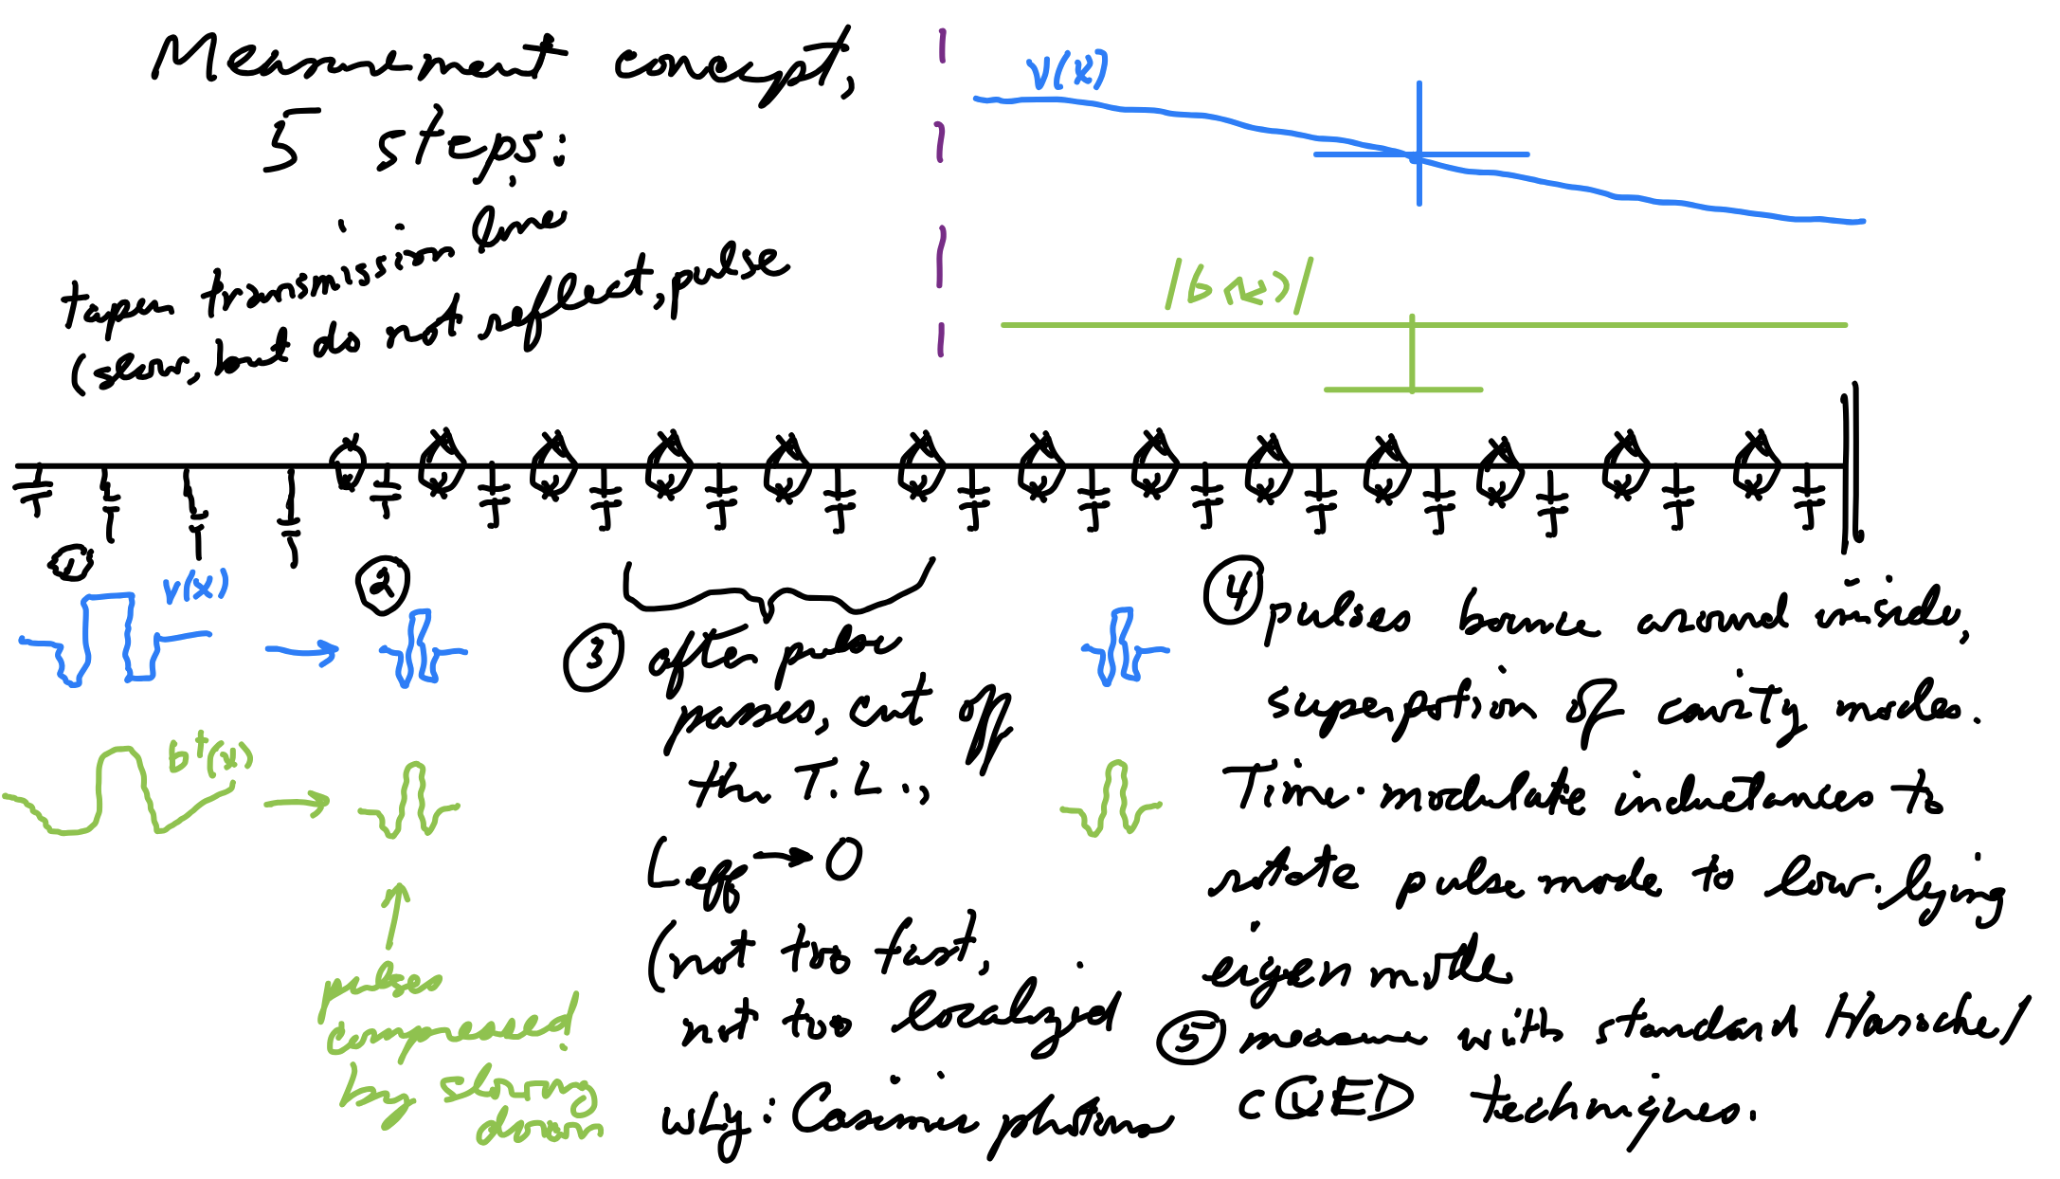

Slide 26
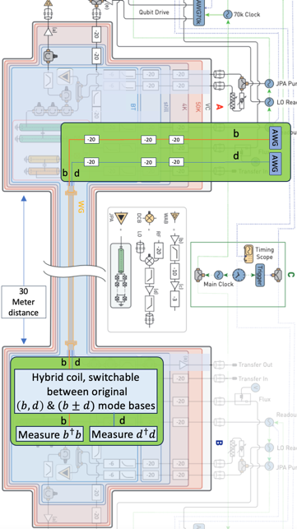

Slide 31
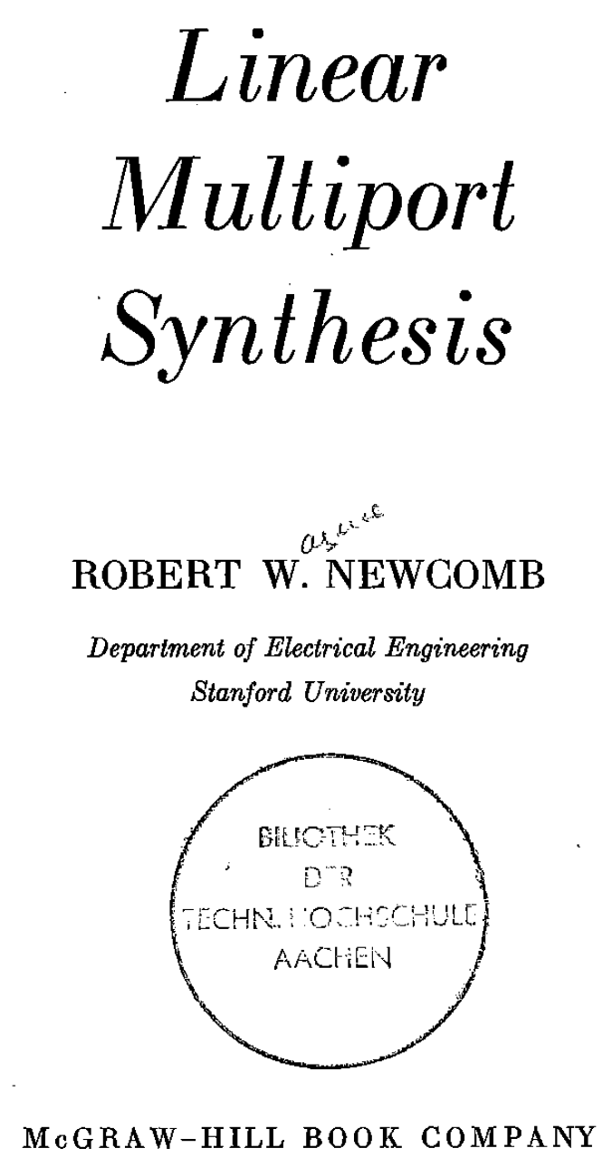
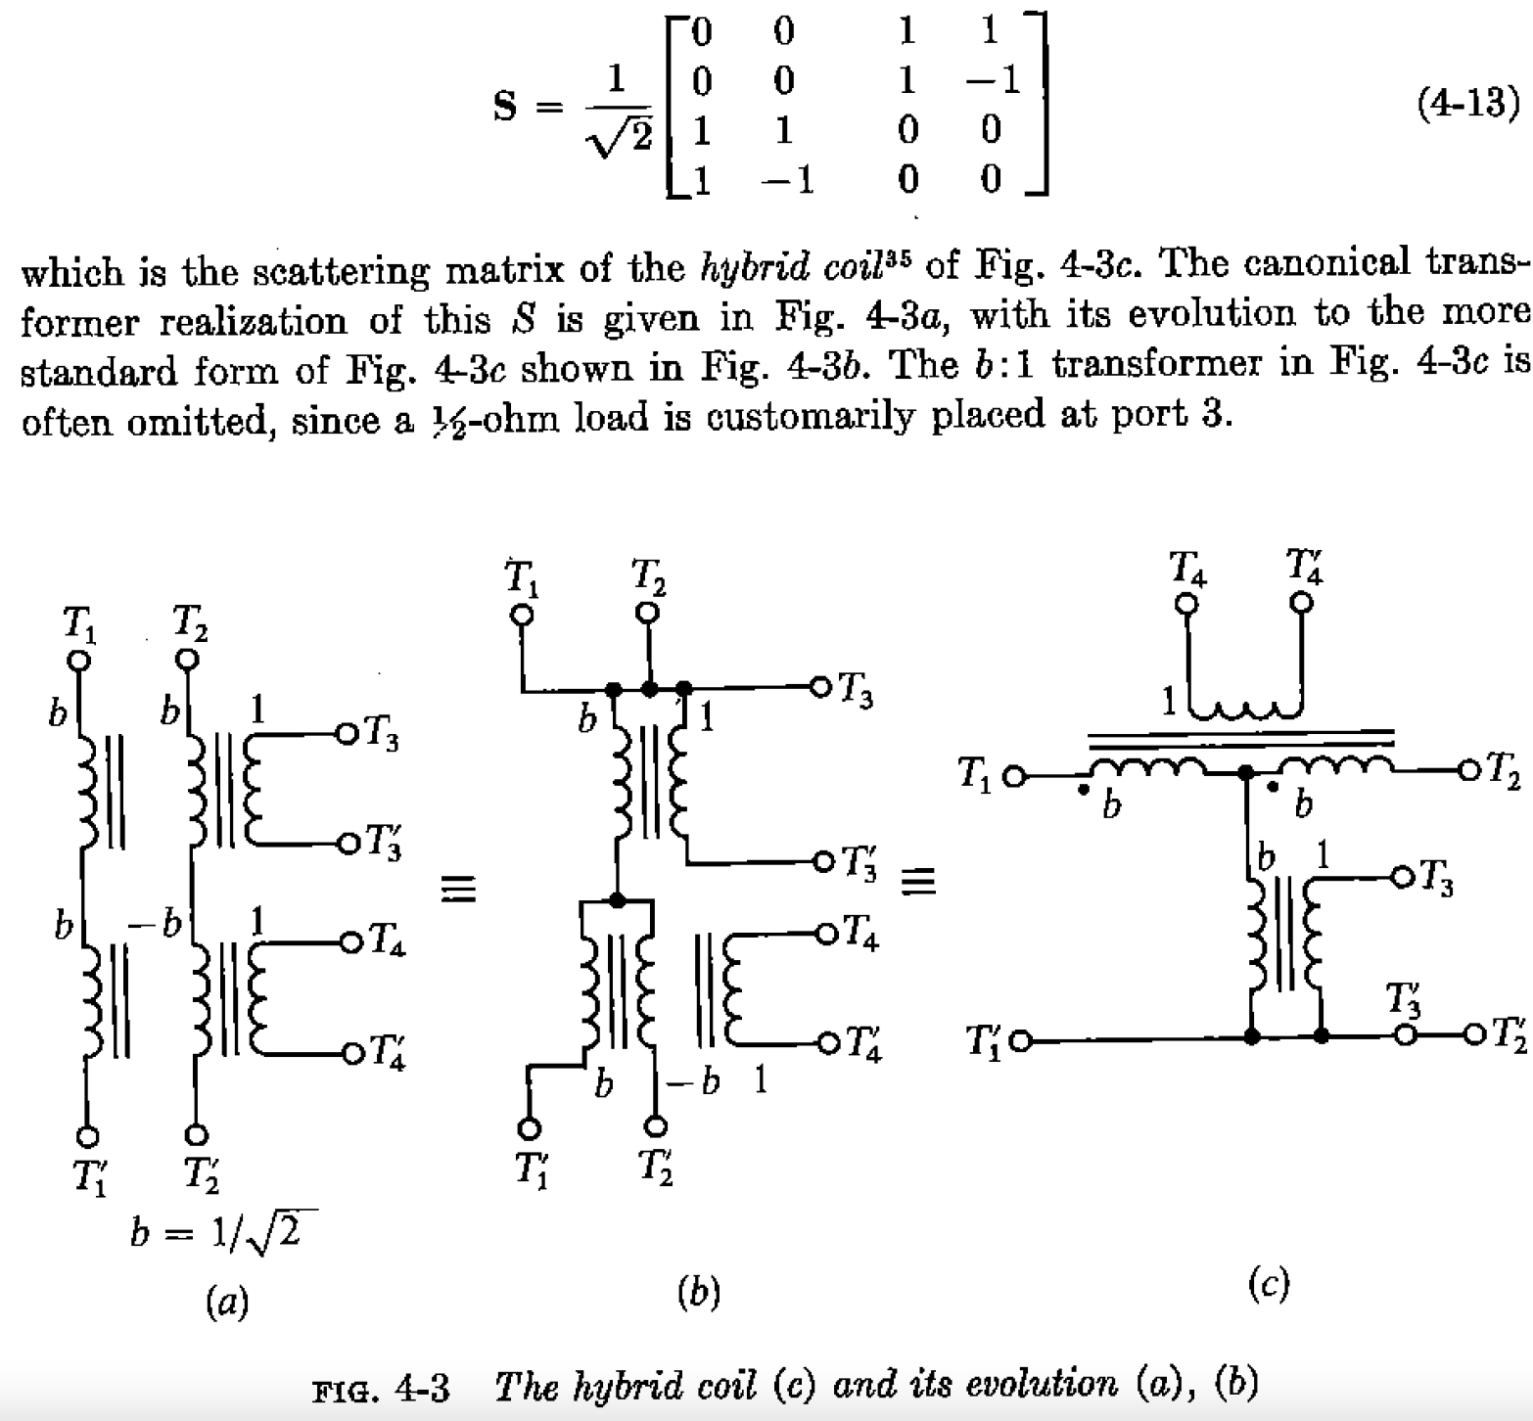
What is the “all pass” 50:50 beamsplitter?

