Slide 1
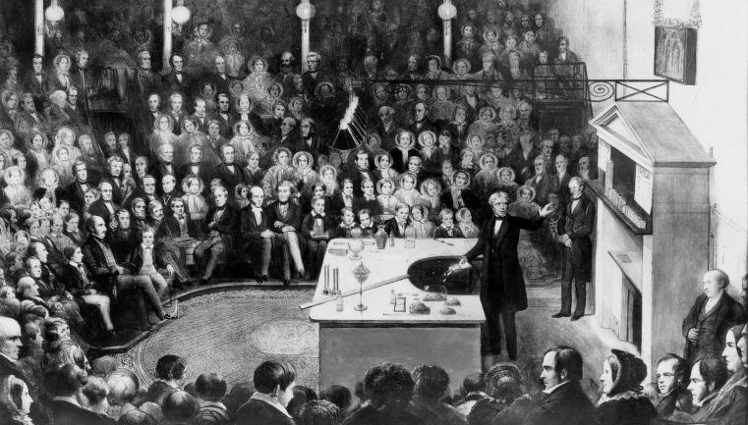

Slide 2
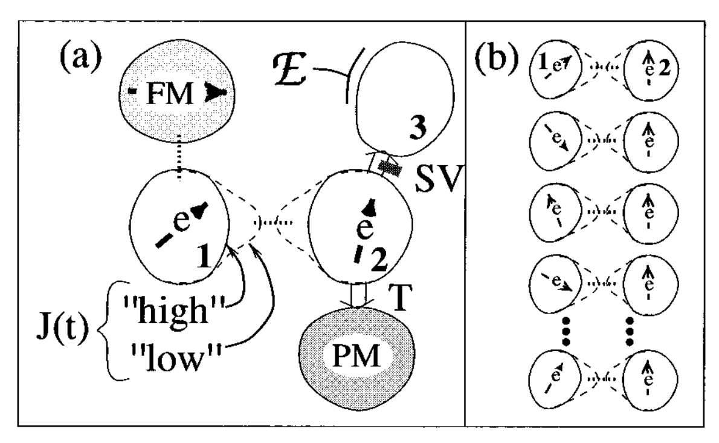
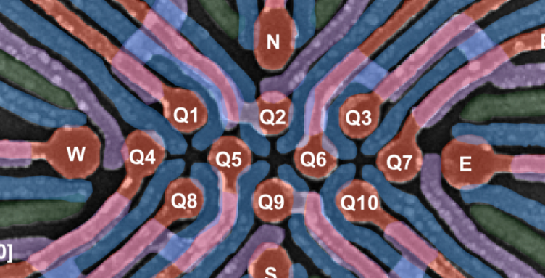
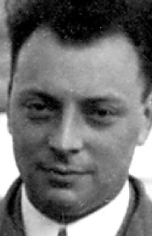
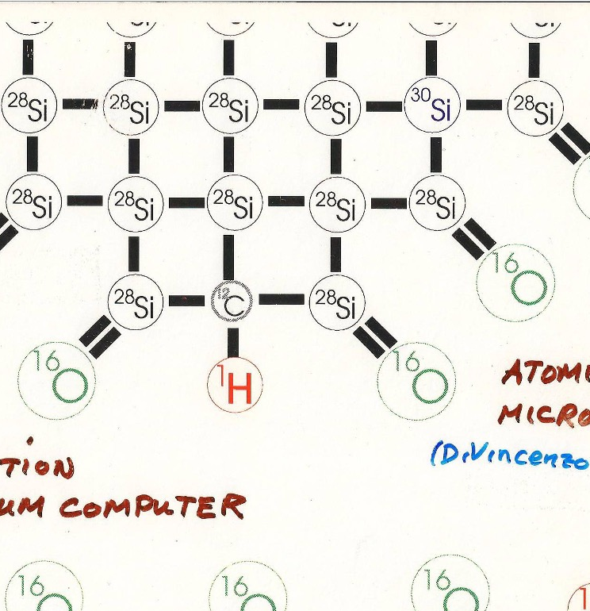
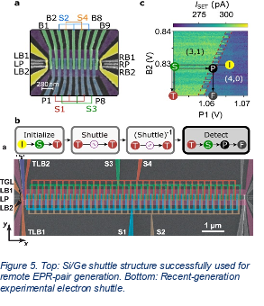
The beautiful physics of spin qubits:
But are they a technology?
17.01.2025 | David Divincenzo

Slide 3
Outline
100 years ago – extra 2-level systems in nature
Spin & quantum tunneling
First spin qubit concepts
Surprising path of experiments
Difficulties slowly overcome
Latest concepts
Route to scalability?

Slide 4

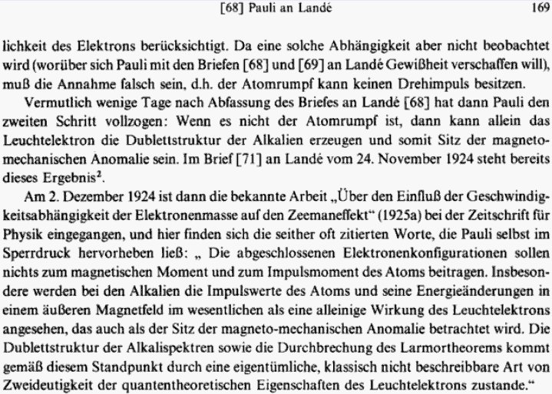
“classically not-describable two-valuedness”
Spin was the first,
but not the only
example
Wolfgang Pauli:
Wissenschaftlicher Briefwechsel mit
Bohr, Einstein, Heisenberg U.a.: Band 1
Notes:
Spin naively is “around the axis”
Pauli knew it doesn’t make sense

Slide 5
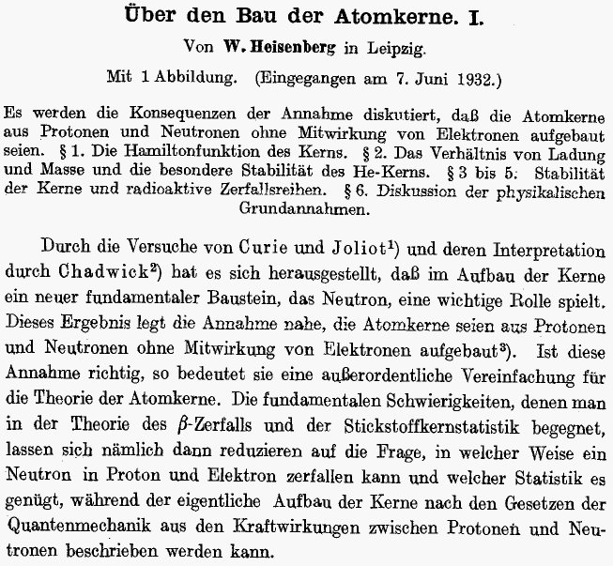
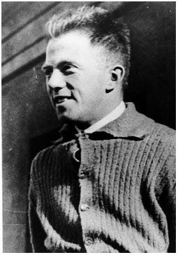
Second use of “classically not describable two-valuedness”

Slide 6
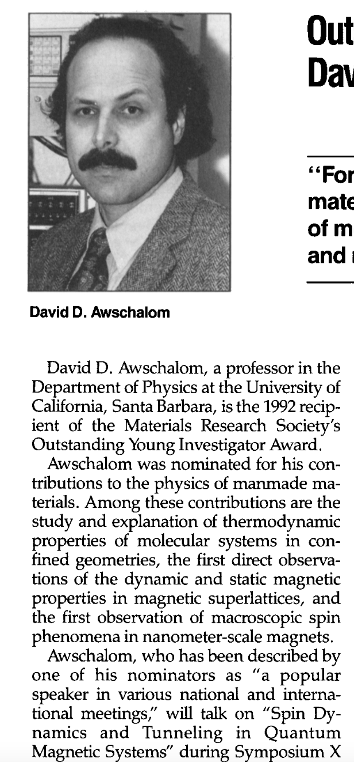
My personal first “qubit”:
D. D. Awschalom, J. F. Smyth, G. Grinstein, D. P. DiVincenzo, and D. Loss, “Macroscopic quantum tunneling in magnetic proteins,” Phys. Rev. Lett. 68, 3092 (1992); 71, 4276(E) (1993).

Slide 7
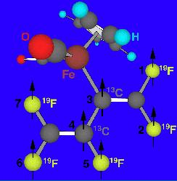
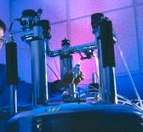
NMR quantum computer –
7 qubit operation
c. 1995:
Nuclear spin
=1/2 for
F-19 and C-13
“Factored 15.”
(Can’t factor 221.)
I.e., not scalable.
Taught us the value of precision instruments
Taught us a lot about control techniques
Liquid-state NMR
NMR spin lattices
Linear ion-trap spectroscopy
Neutral-atom optical lattices
Cavity QED + atoms
Linear optics with single photons
Nitrogen vacancies in diamond
Electrons on liquid He
Small Josephson junctions
  “charge” qubits
  “flux” qubits
Spin spectroscopies, impurities in semiconductors
Coupled quantum dots
  Qubits: spin,charge,excitons
  Exchange coupled, cavity coupled
Notes:
dicarbonylcyclopentadienyl (perfluorobutadien-2-yl) iron (C₁₁H₅F₅O₂Fe )

Slide 8
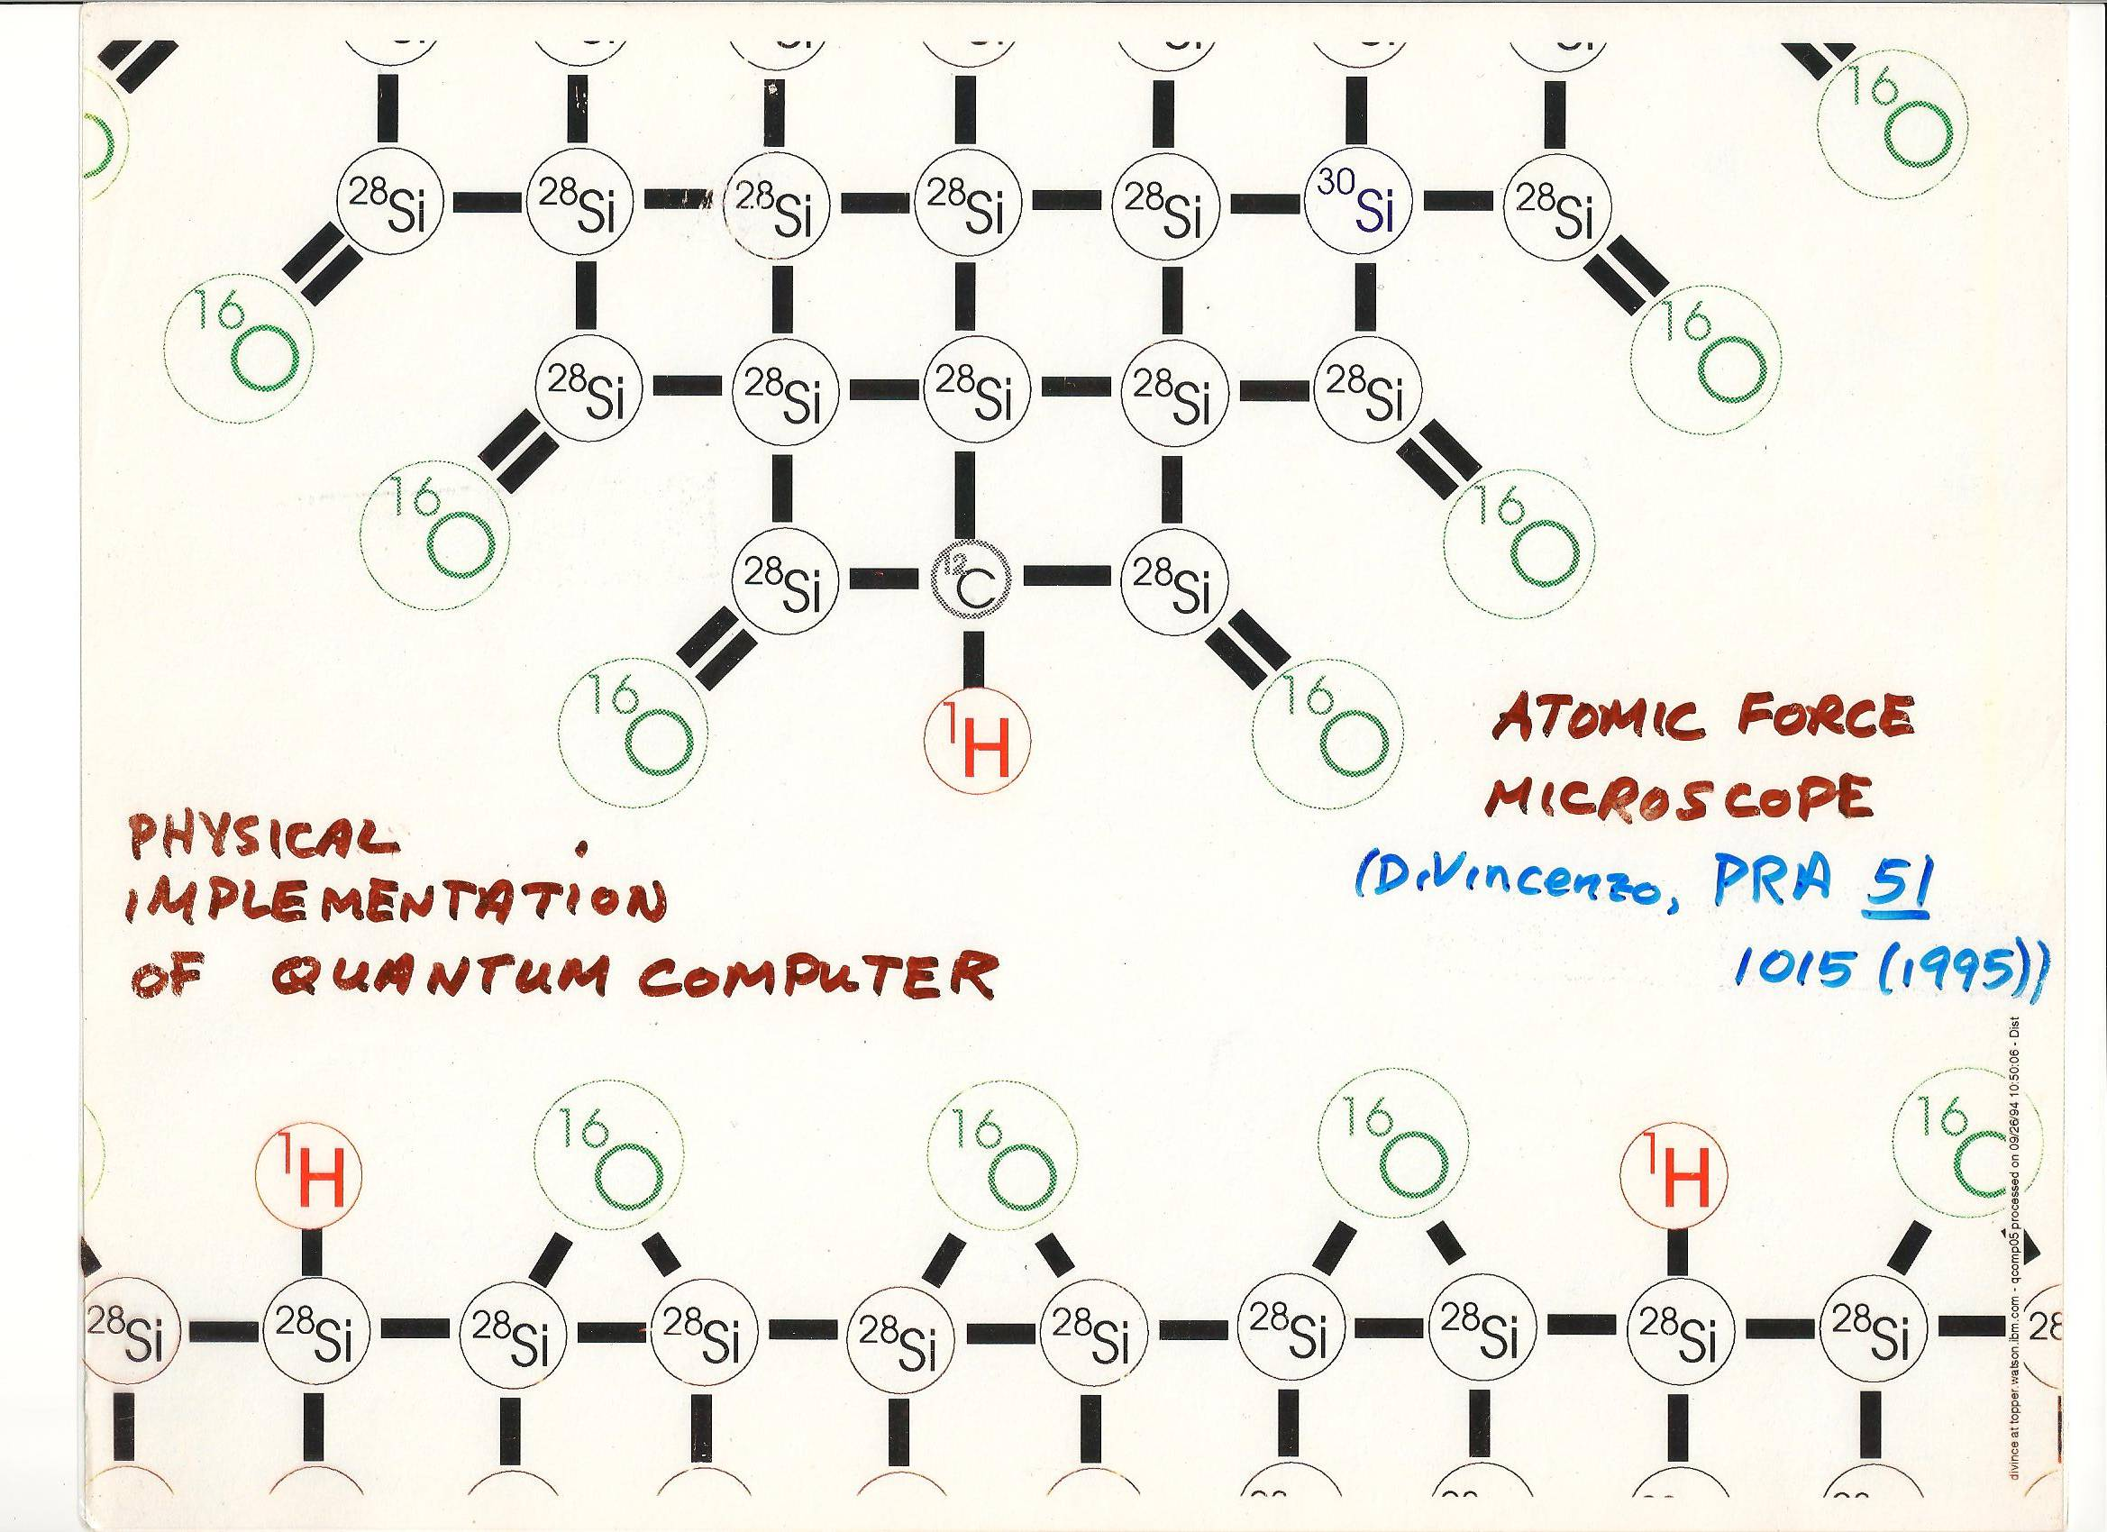
Example: early idea -- nanostructure for control of (nuclear) spin
scanning tip
DiVincenzo, Phys Rev. A 51, 1015 (1995)
Science 270, 255 (1995).

Slide 9
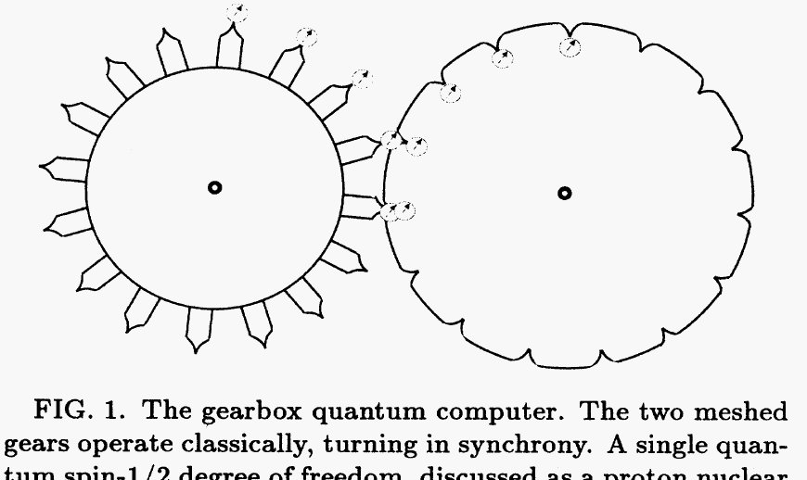
“Gearbox quantum computer”. Not realistic. But, was a motivation for two
different directions in quantum computing research…
From DiVincenzo, “Two-bit gates are universal for quantum computing,”
Phys Rev. A 51, 1015 (1995)

Slide 10
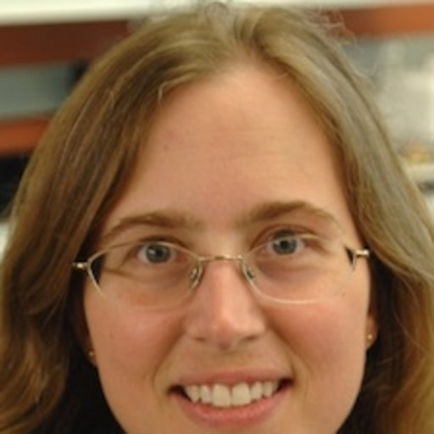
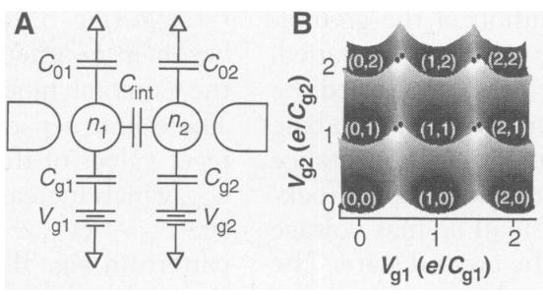
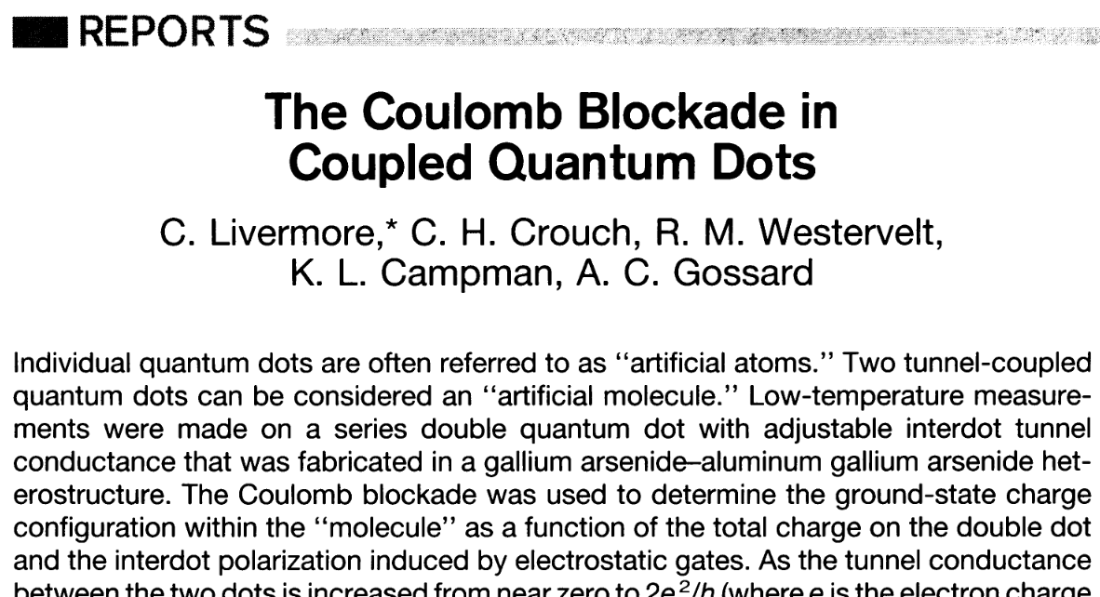
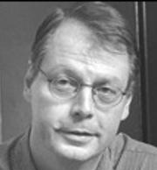
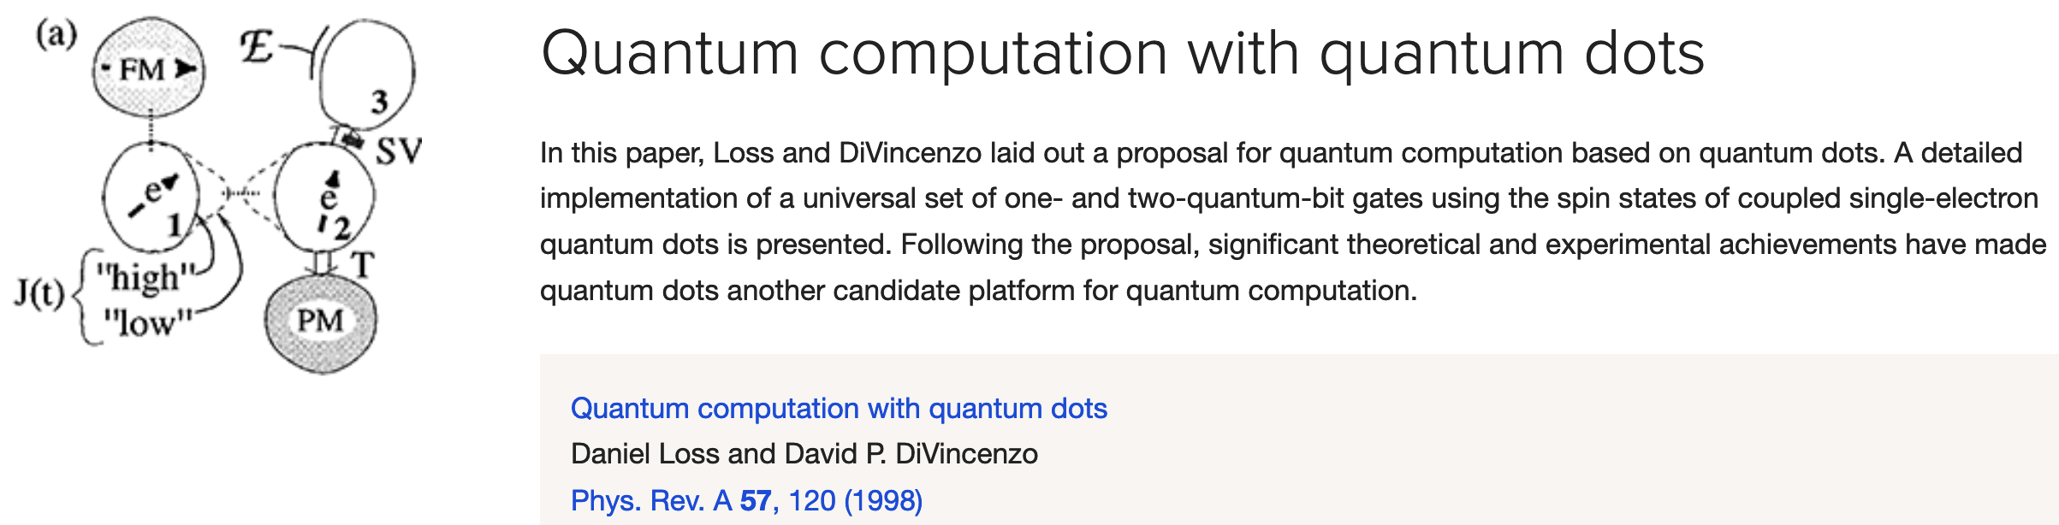


Slide 11
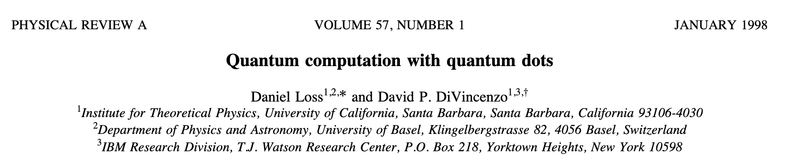
Extrapolating Livermore et al. to a quantum computer (LD 1998):
Based on nonrelativistic ideas
  Spin & orbit are uncoupled, except via particle statistics
  Leads to very low coupling to some parts of the environment
  Symmetry determined spin-spin coupling (Heisenberg)
But, problems with nonrelativistic philosophy:
  Strength of Heiserberg interaction sensitive to environmental electric fields
  For control, invoke (relativistic) magnetic controls
Other decoherence channels not really thought through (hyperfine effects)
Very naïve from the point of view of scalability

Slide 12
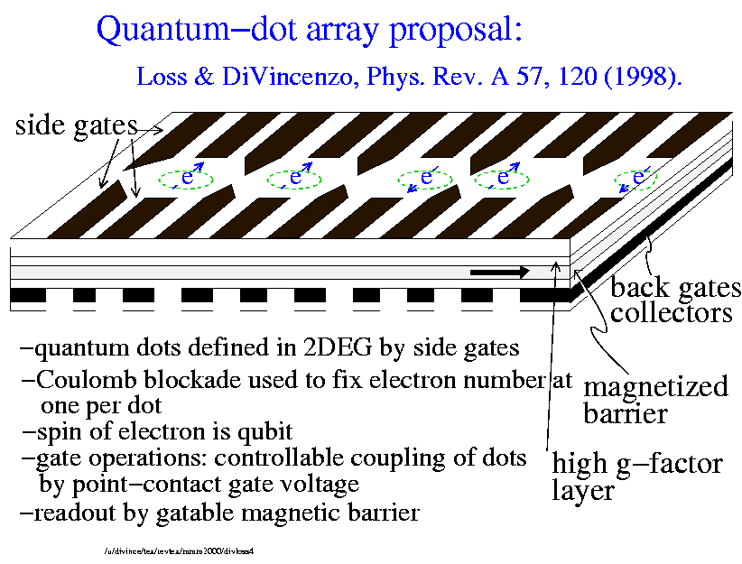
Quantum-dot array proposal
Gate operations with quantum dots (1):
--two-qubit gate:
Use the side gates to move electron positions
horizontally, changing the wavefunction overlap
Pauli exclusion principle produces spin-spin interaction:
Model calculations (Burkard, Loss, DiVincenzo, PRB, 1999)
For small dots (40nm) give J~ 0.1meV, giving a time for the
“square root of swap” of
t ~ 40 psec
NB: interaction is very short ranged, off state is accurately H=0.

Slide 13
Can we get CNOT with just Heisenberg exchange? i.e., can Q. computing be done completely nonrelativistically?
Conventional answer– NO:
--because Heisenberg interaction has too much symmetry
--it cannot change
S (total angular momentum quantum number)
S_{z} (z component of total angular momentum)
Correct answer (Berkeley & others) – YES:
--the trick: encode qubits in states of specific angular momentum
quantum numbers, with tensor-power structure
-- examples of these sectors with N spins:
Hilbert space dimension 2^{(N/4)} (singlet, S=0)
Hilbert space dimension 2^{(N/3)} (S_{z}=+N/6, simultaneous in multiple S sectors)

Slide 14
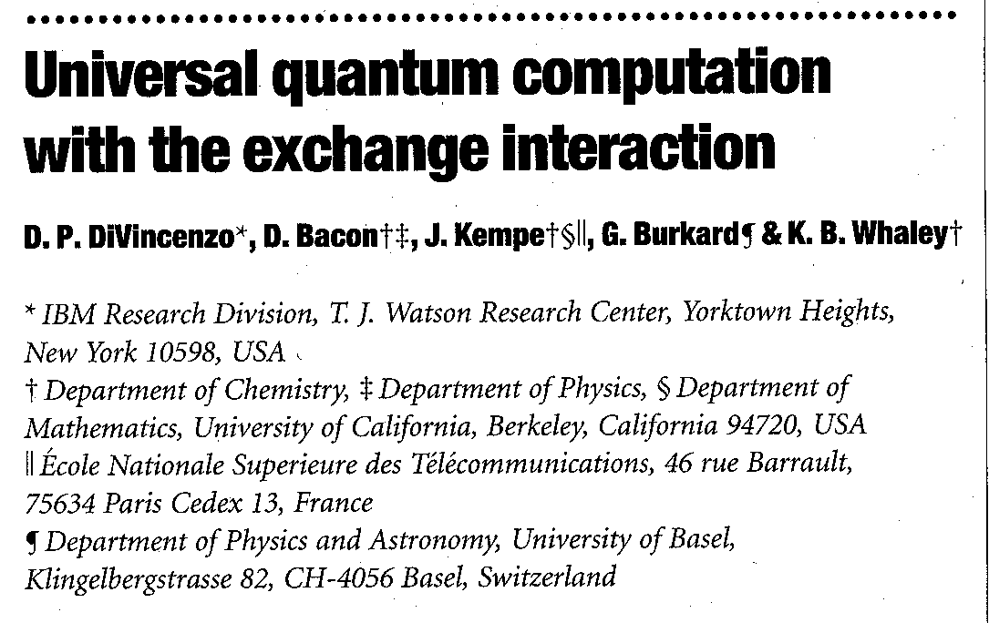
Specific scheme to get quantum gates with just
Heisenberg exchange:
Most economical coding scheme:
1 qubit = 3 spins:
(i.e., singlet times spin-up)
(triplet on first two
spins)
Because quantum numbers are fixed (S=1/2, S_{z}=+1/2), all gates on
These logical qubits can be performed using SWAP:
from mrs2002

Slide 15
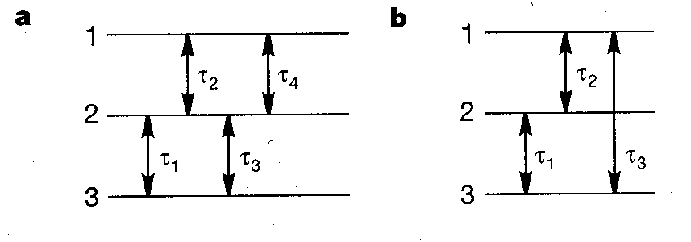
Economical coded-gate implementations— results of simulations
By varying interactions times shown,
all 1-qubit gates on coded qubits can be obtained with no more
than 4 exchange operations (if only nearest-neighbor interactions)
or 3 exchange interactions (if interactions between spin 1 and spin 3
are possible)
Focus of R&D at HRL research lab (Malibu) for many years

Slide 16
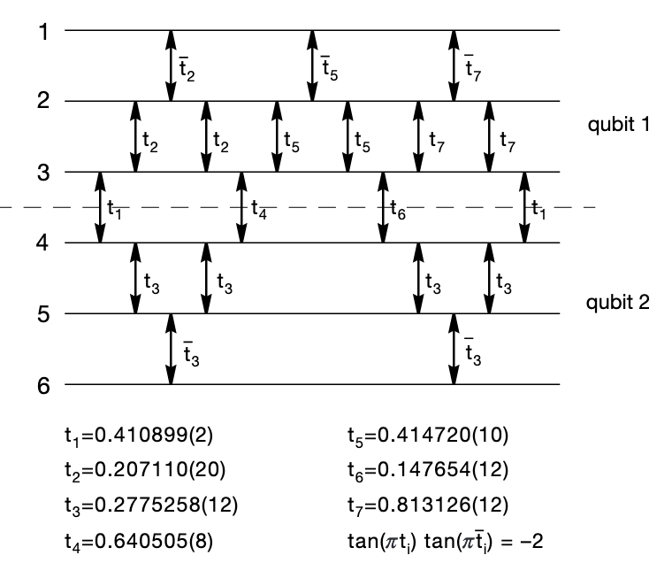
CNOT on two coded qubits
-minimal solution
19 interactions,
doable in 13 time steps
-essentially unique
-gate accuracy ~10⁻⁵
with precision shown
-nearest-neighbor
seems best

Slide 17
Simple features of scheme for coded computation
--Initialization: turn on uniform B field and strong antiferromagnetic
Heisenberg exchange between spins 1 and 2. Then
is the ground state of the system.
--Measurement: coded qubit is measured by determining whether
spins 1 and 2 are in a relative singlet or triplet. Somewhat easier
than single-spin measurements.

Slide 18
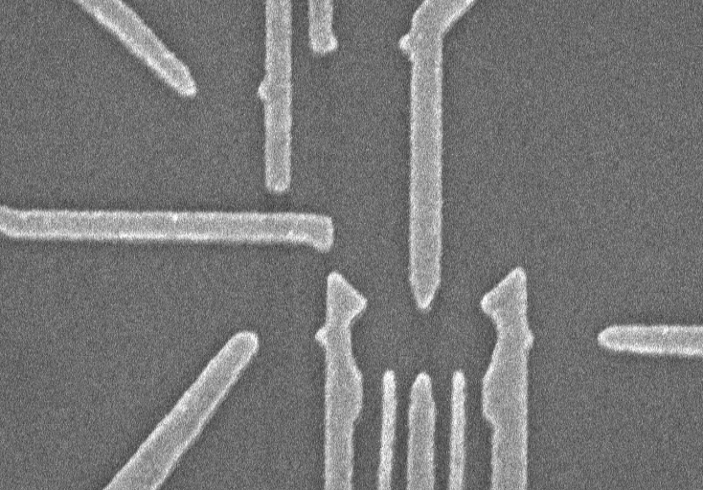
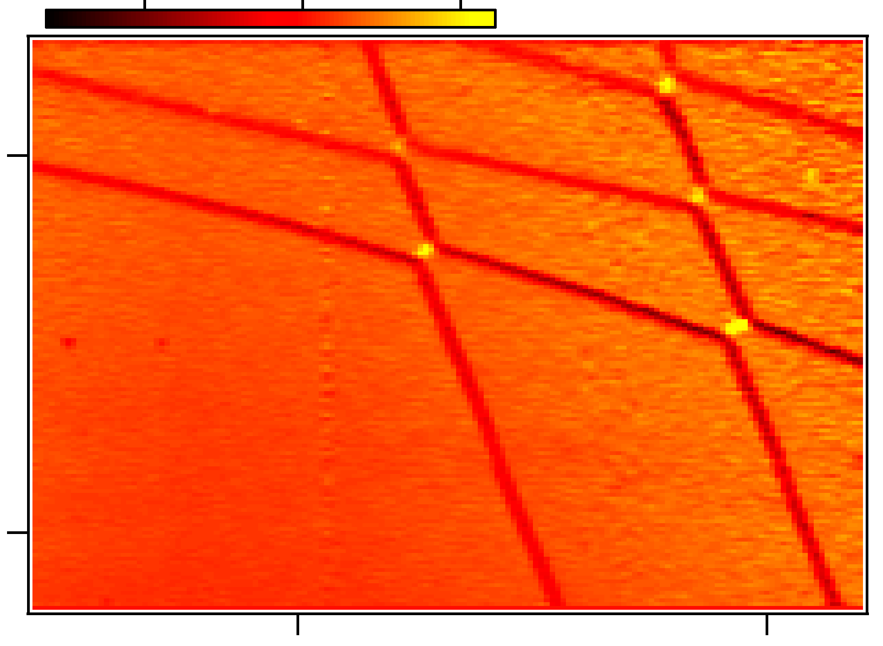
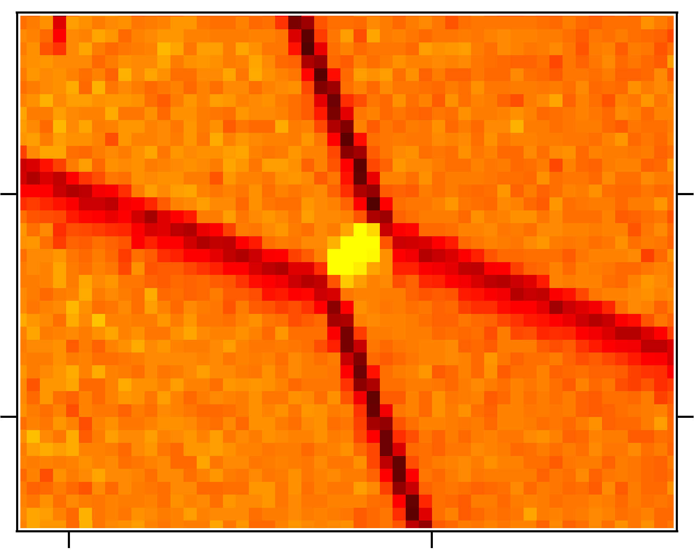
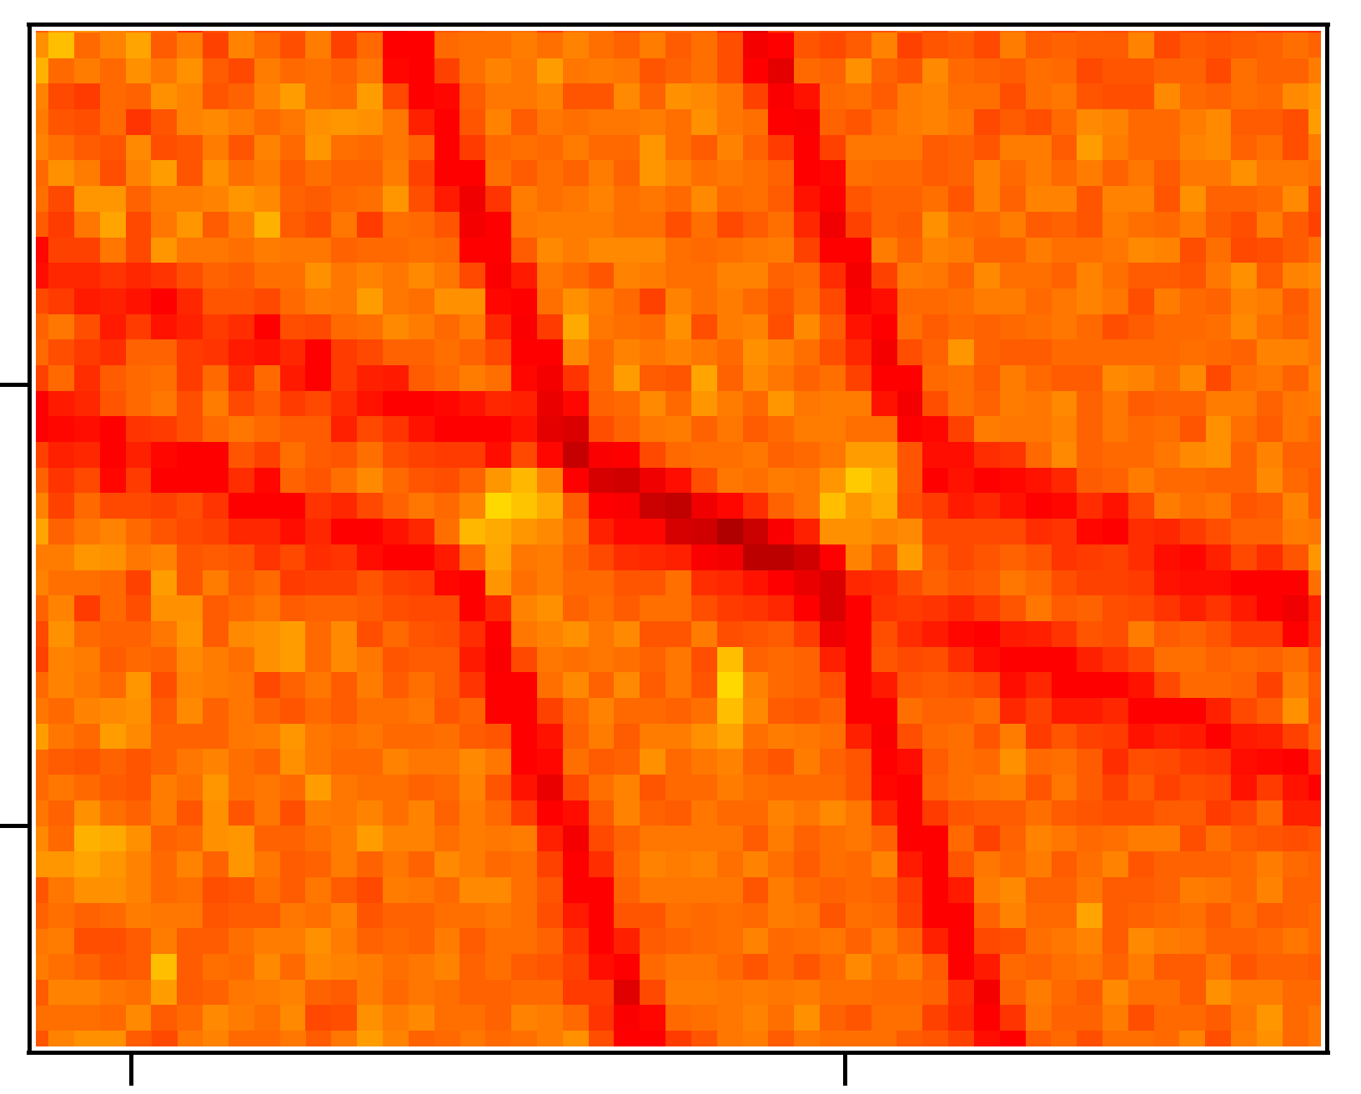
c. 2005
Details of Charlie Marcus group structures and measurements
-- full electric circuit, measurement by spin-charge conversion
-- charging honeycomb, termination at empty dots
a)
9
10
11
12
b)
-5
0
5
dG_{S}/dV₆ (a.u.)
(2,0)
0.5 μm
(2,1)
-500
(1,0)
(2,2)
(1,1)
8
(1,2)
V₆ (mV)
(0,0)
(0,1)
(0,2)
1
G_{S}
P
-550
7
V
2
P
6
5
4
3
2
-20 dB
V₂ (mV)
V
-20 dB
-450
-400
c)
6
d)
P
V =25 mV
(1,1)
2
(1,1)
(1,2)
τ=10 μs
(1,0)
-520
V₆ (mV)
ΔV
(0,1)
-400
(0,1)
(0,0)
(0,2)
-530
-415
V₂ (mV)
-415
V₂ (mV)
-400

Slide 19

Two-electron spin qubits, c. 2012
GaAs heterostructure
Electrostatic gates
Si doping
90 nm
-
+
+ + + + + + + + + + + +
Al_{0.3}Ga_{0.7}As
2D electron gas
GaAs
Individual confined electrons
Lengthy efforts to mitigate hyperfine effects (Ga & As nuclei)
Gradual realization: Si and Ge are better (many spin-zero nuclei)
Thanks to Hendrik Bluhm, RWTH

Slide 20
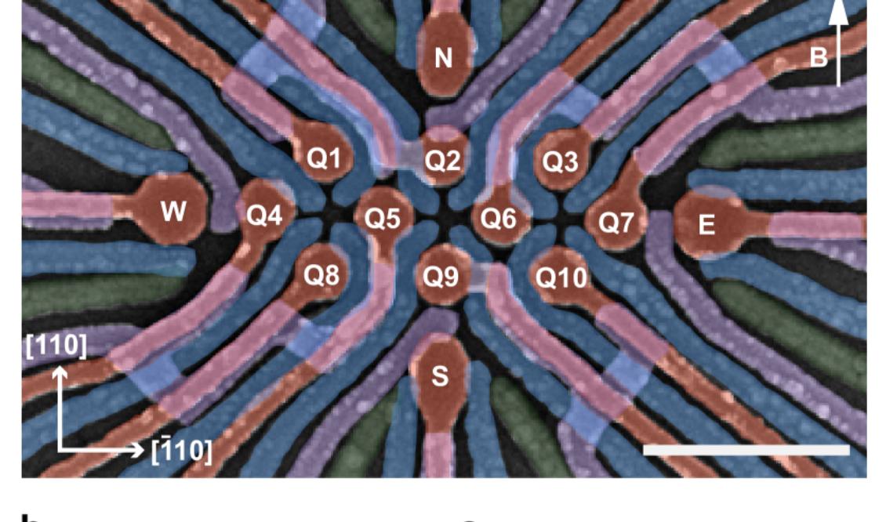
Present developments:
  Much improved spin qubits with Si/Ge
  >99% gate fidelities (not 99.9%)
  Multiqubit structures are working (~16)
  Boast: “million qubits on a chip”
    Very misguided – not scalable!
2024
300nm

Slide 21
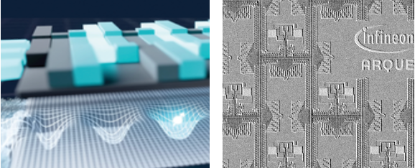
Partial solution for scalability problem:
  Electron shuttle:
    Move single electron in gated structure by several microns
    OK state fidelity now achieved
    Leads to Infineon/ARQUE scalable architecture
    Problem: extra valley quantum number

Slide 22
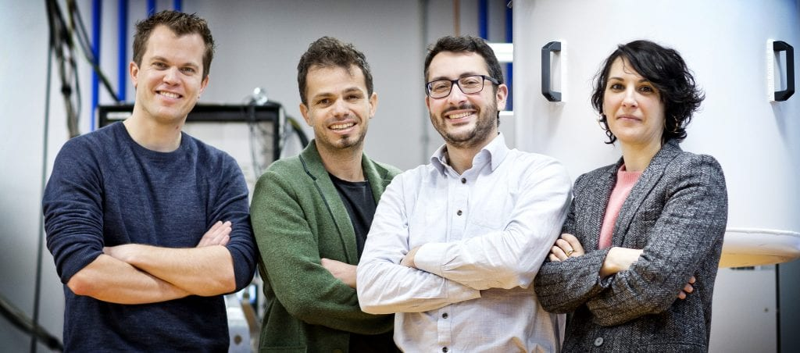
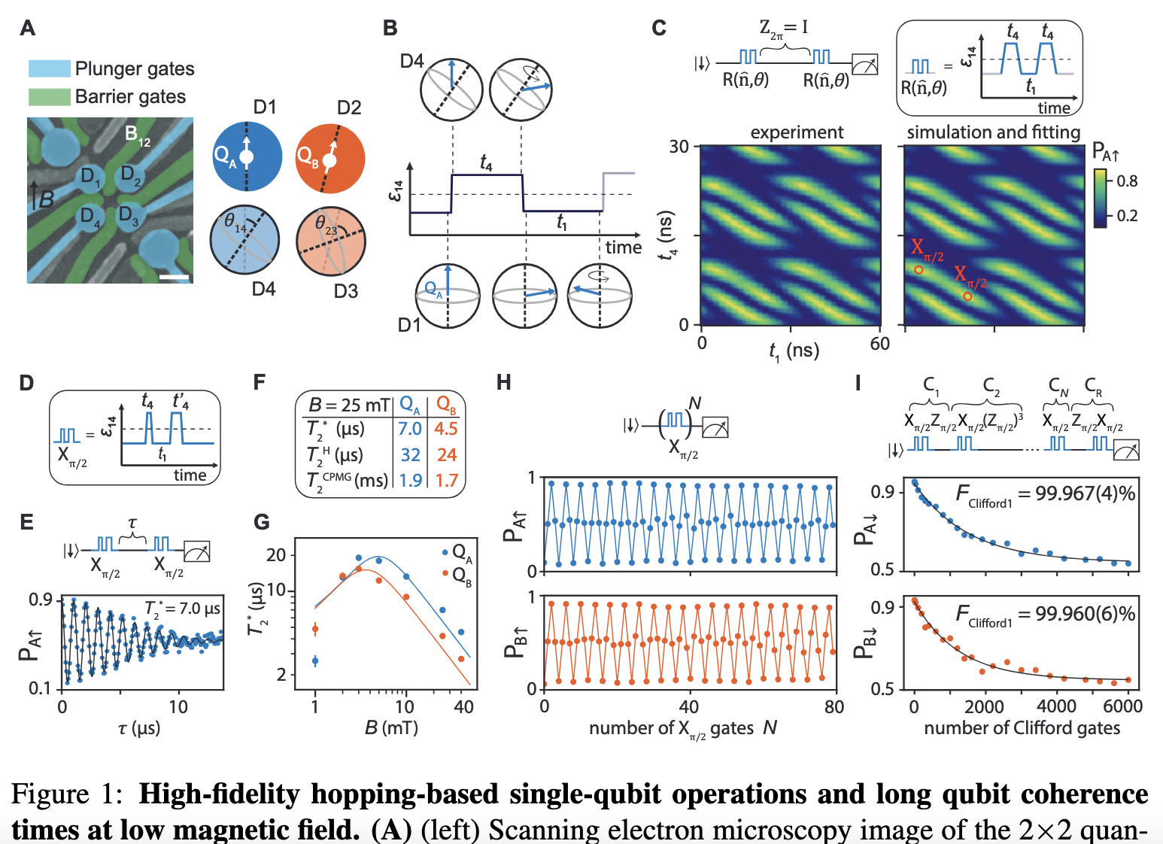
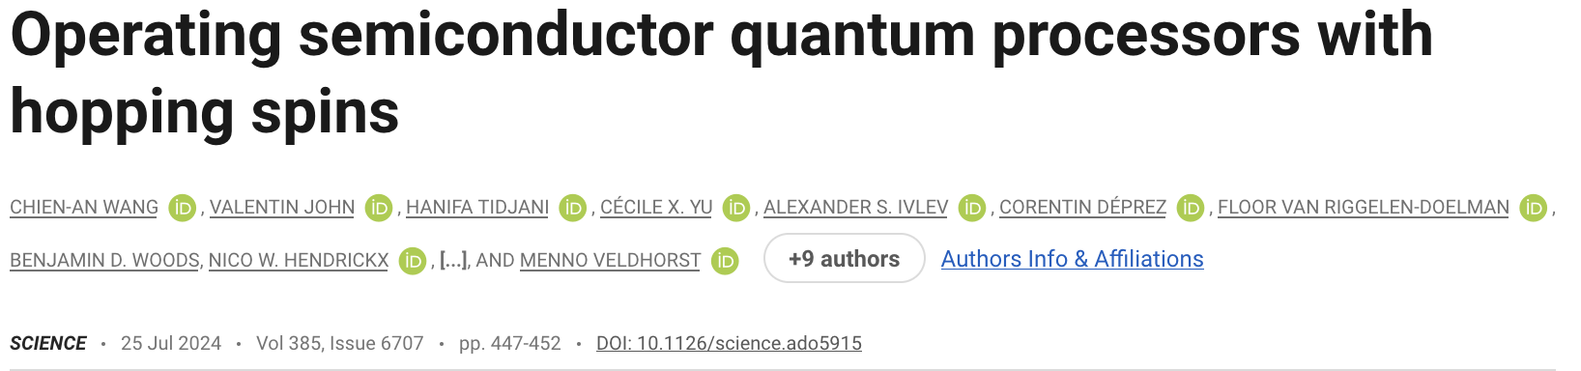
New development:
  Several problems solved by going to holes
  Different heterostructure, primarily Ge
Veldhorst Scappucci
300nm

Slide 23
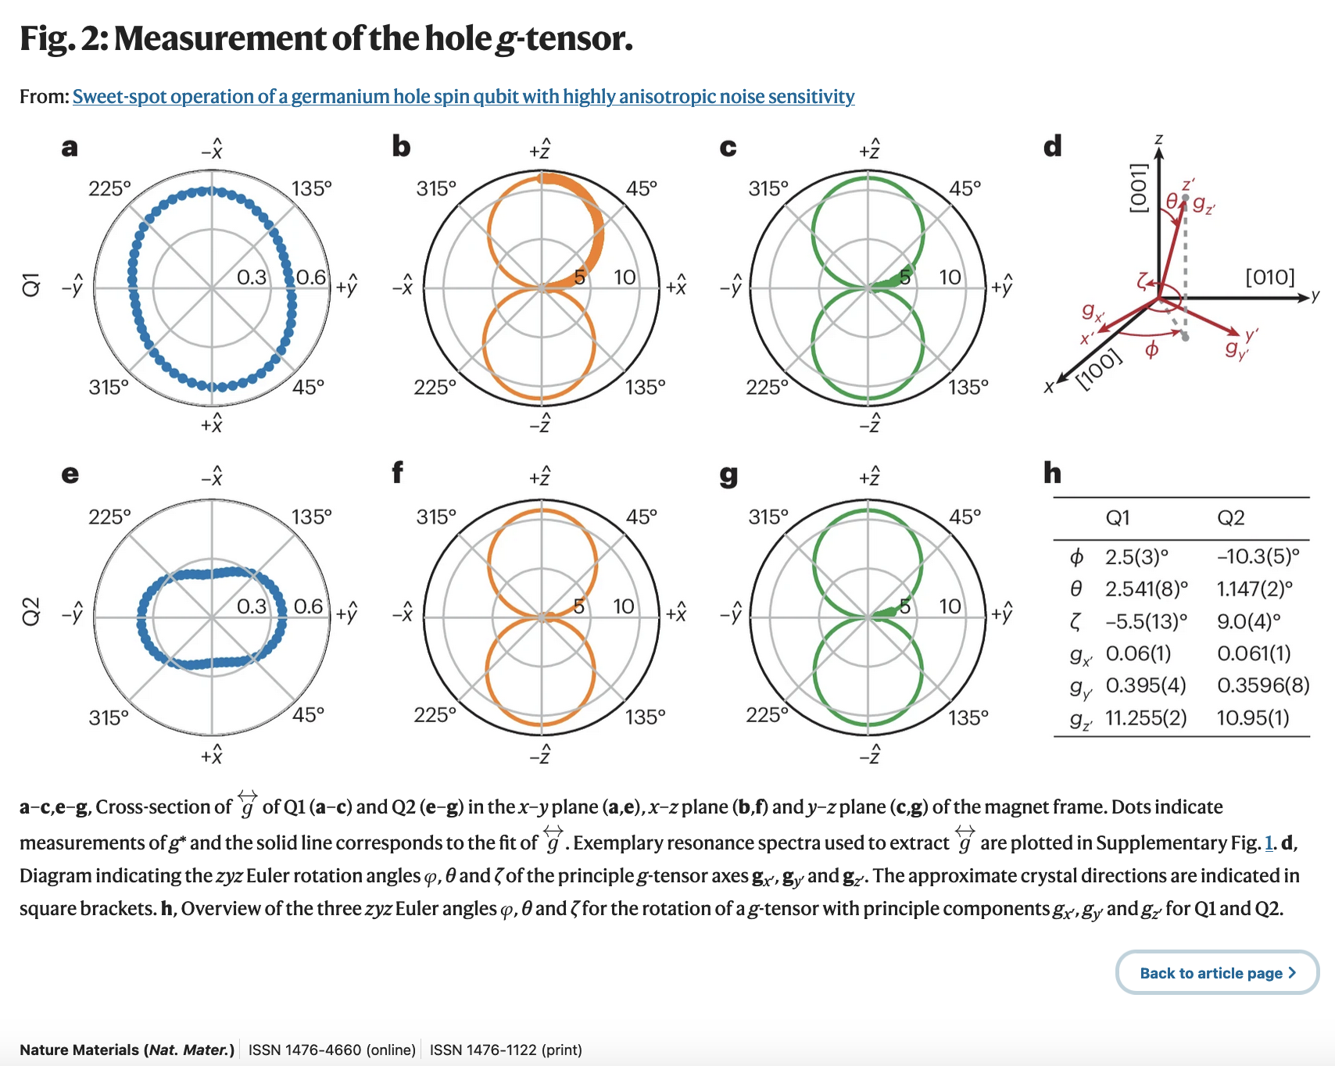
Completely different from Loss/DiVincenzo paradigm, highly relativistic:
  Holes, as described by Luttinger Hamiltonian, have complex anisotropy
  g factor structure
    g_{zz}>>2
    g_{xx,} g_{yy} ~ 0
    Principal axes slightly rotated

Slide 24
Completely different from Loss/DiVincenzo paradigm, highly relativistic
  Holes, as described by Luttinger Hamiltonian, have complex anisotropy
  g factor structure
    g_{zz}>>2
    g_{xx,} g_{yy} ~ 0
    Principle axes slightly rotated
  But, successful gates by LD mechanism:
  Hole transferred to dot with rotated principle axes, causes Bloch-vector rotation
  Excellent fidelity achieved
300nm

Slide 25
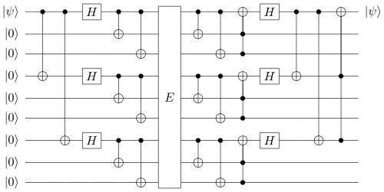
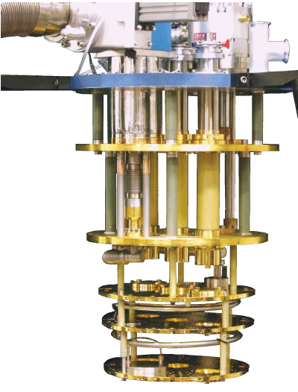
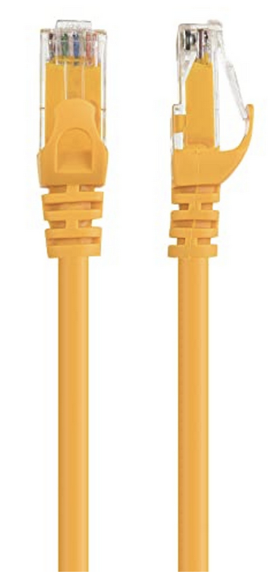
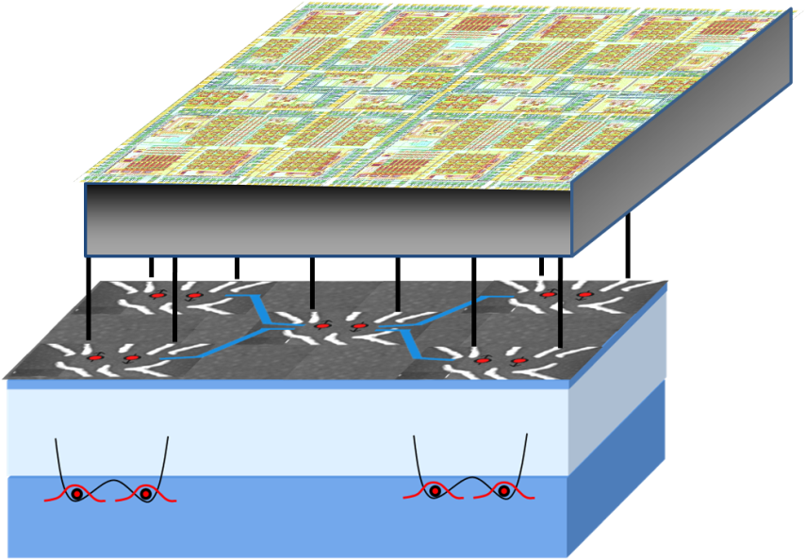
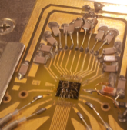
Prospective architecture:
Cold control circuits
Very few cables into cryostat
my skepticism:
  Power consumption
  minaturization

Slide 26
Observations
Spin qubits: “moderate success”
Explores many interesting physics ideas
Problems of excessive decoherence, extra degrees of freedom slowly overcome
Novel discussions of scaling route, many problems can be foreseen
Revived modern attention to beautiful aspects (e.g., Kohn-Luttinger picture) of semiconductor physics

Slide 28
Quantum-dot array proposal

Slide 29
Five criteria for physical implementation of a quantum computer
Well defined extendible qubit array -stable memory
Preparable in the “000…” state
Long decoherence time (>10⁴ operation time)
Universal set of gate operations
Single-quantum measurements
D. P. DiVincenzo, in Mesoscopic Electron Transport, eds. Sohn, Kowenhoven, Schoen (Kluwer 1997), p. 657, cond-mat/9612126; “The Physical Implementation of Quantum Computation,” Fort. der Physik 48, 771 (2000), quant-ph/0002077.

Slide 30
5. Measurement requirement
Ideal quantum measurement for quantum computing:
For the selected qubit:
if its state is |0, the classical outcome is always “0”
if its state is |1, the classical outcome is always “1”
(100% quantum efficiency)
If quantum efficiency is not perfect but still large (50%), desired measurement is achieved by “copying” (using cNOT gates) qubit into several others and measuring all.
If q.e. is very low, quantum computing can still be accomplished using ensemble technique (cf. bulk NMR)
Fast measurements (10⁻⁴ of decoherence time) permit easier error correction, but are not necessary

Slide 31
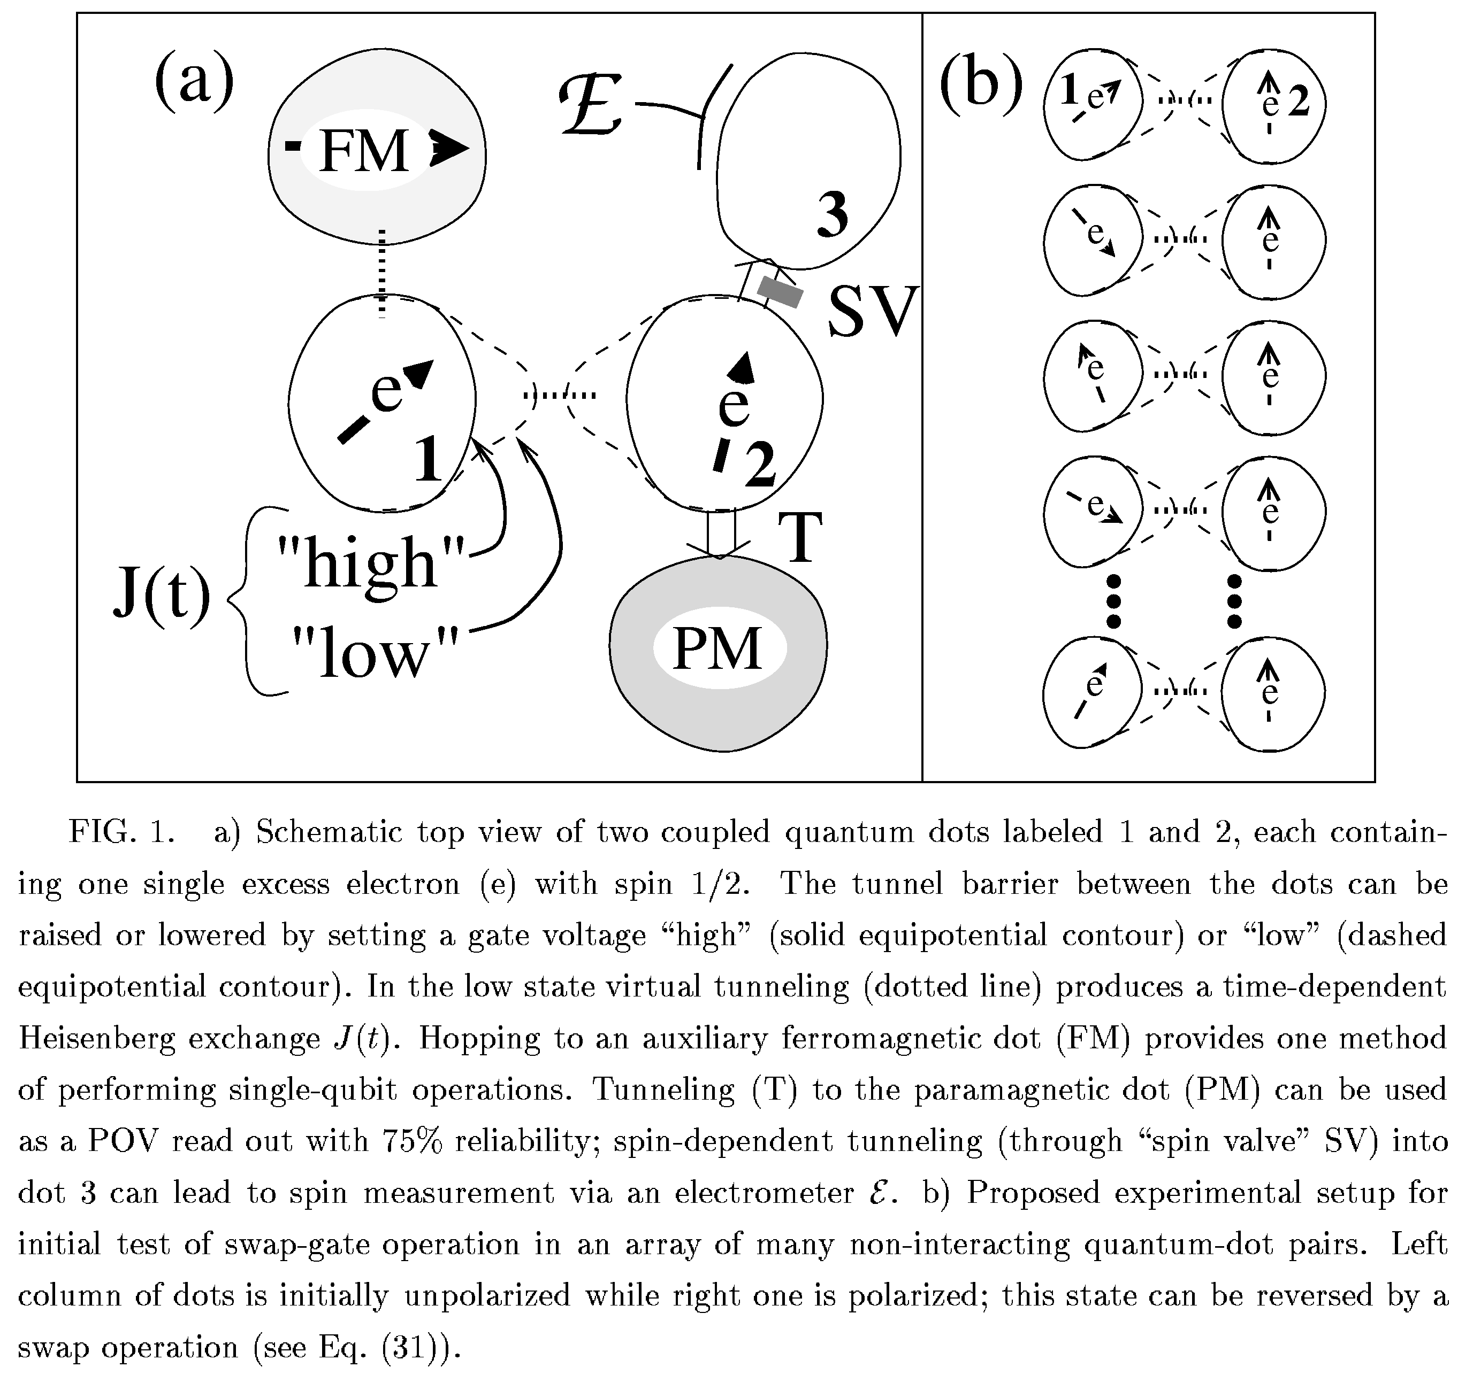
Loss & DiVincenzo
quant-ph/9701055

Slide 32
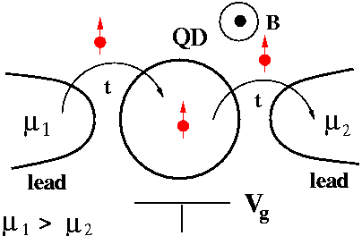
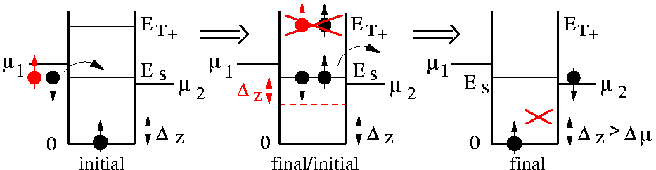

Quantum Dot as Spin Filter and Spin Read-out
Quantum Dot weakly coupled to leads
in the Coulomb blockade regime,
in the presence of a magnetic field B
Spin-polarized current Is
vs. leakage current Ic:
>>1 !

Slide 33
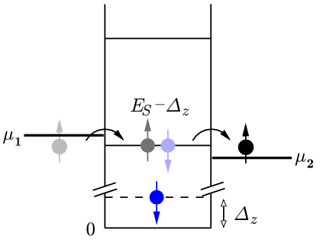
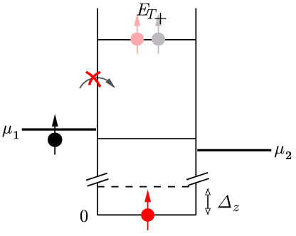


Spin Read-out via Spin Polarized Leads
Quantum dot attached to spin-polarized leads*
P. Recher, E.V. Sukhorukov, D. Loss, Phys. Rev. Lett. 85, 1962 (2000)
Thus: I_{s} = 0
spin up ( I_{c} << I_{s} )
I_{s} > 0
spin down
=> single-spin memory device, US patent PCT/GB00/03416
* - magnetic semiconductors [R. Fiederling et al., Nature 402, 787 (1999); Y. Ohno et al., Nature 402, 790 (1999)]
- Quantum Hall Edge states [M. Ciorga et al., PRB 61, R16315 (2000)],

Slide 34
4. Universal Set of Quantum Gates
Quantum algorithms are specified as sequences of unitary transformations U₁,U₂, U₃, each acting on a small number of qubits
Each U is generated by a time-dependent Hamiltonian:
Different Hamiltonians are needed to generate the desired quantum gates:
1-bit gate
many different “repertoires” possible
integrated strength of H should be very precise, 1 part in 10⁻⁴,
from current understanding of error correction
(but, see topological quantum computing (Kitaev, 1997))

Slide 35
Making the CNOT from exchange:
Exchange generates the
“SWAP” operation:
More useful is the “square root of swap”,
=
Using SWAP:

CNOT

Slide 36
Quantum-dot array proposal
Gate operations with quantum dots (2):
--one-qubit gate:
Desired Hamiltonian is:
One approach: use back gate to move electron
vertically. Wavefunction overlap with magnetic
or high g-factor layers produces desired Hamiltonian.
If B_{eff}= 1T, t ~160 psec
If B_{eff}= 1mT, t ~ 160 nsec

Slide 37
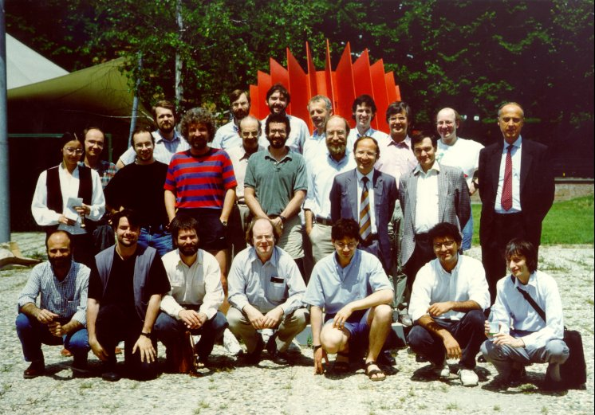
Institute for Scientific Interchange,
Torino, 1993

Slide 38
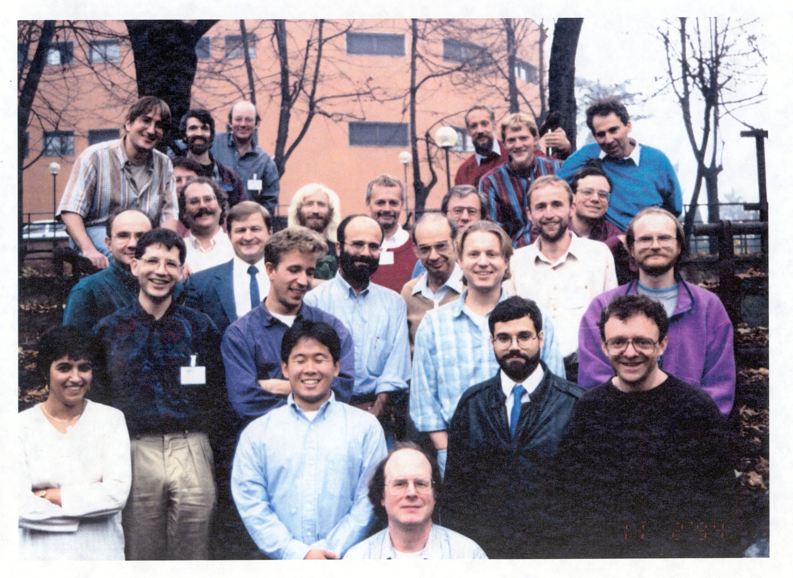
Institute for Scientific Interchange,
Torino, 1994
Notes:
Need photo

Slide 40
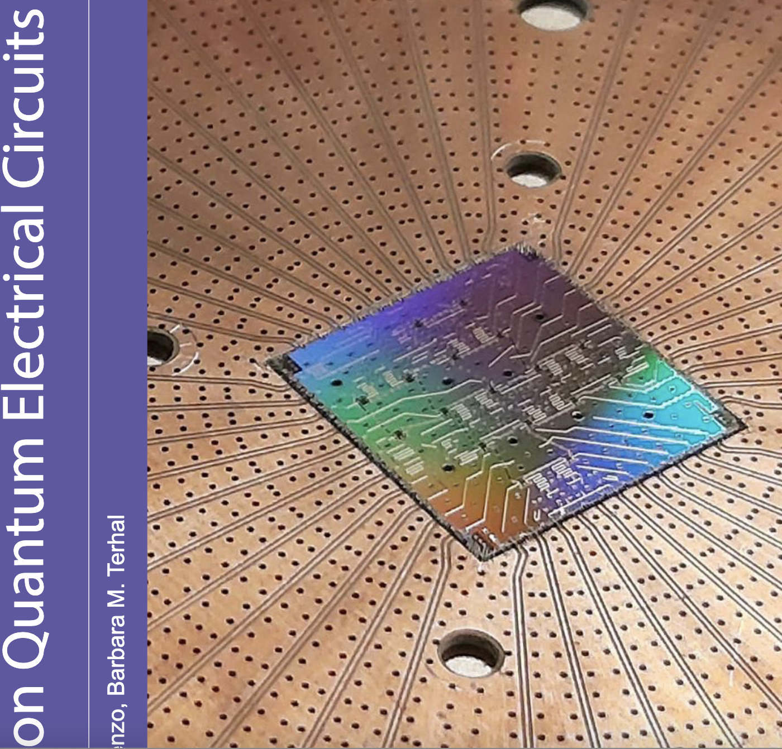
https://textbooks.open.tudelft.nl/textbooks/catalog/book/85
Or search string “terhal divincenzo circuits lecture notes”

Slide 42
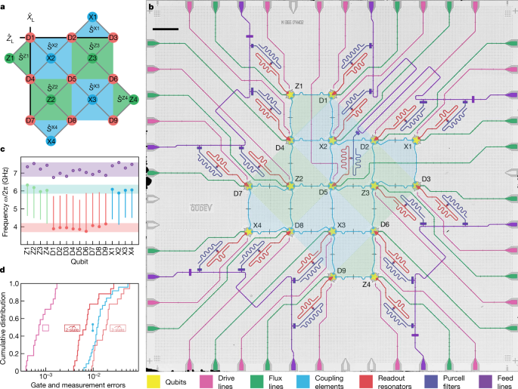

Slide 43
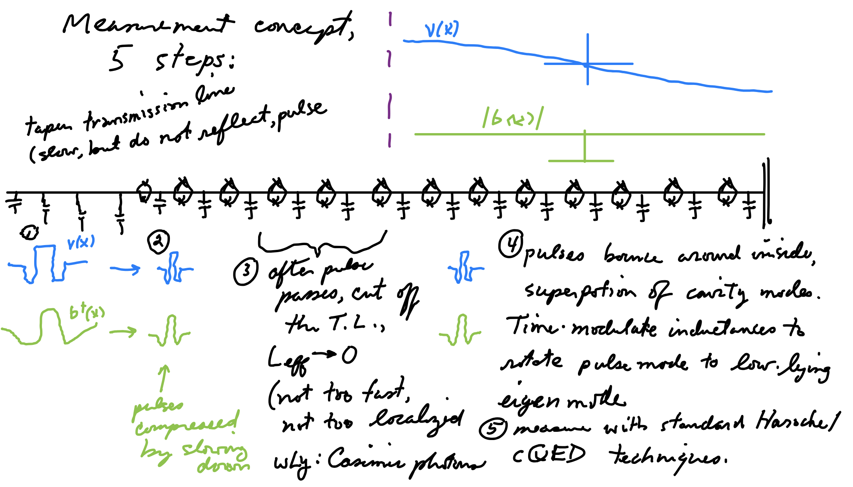

Slide 44
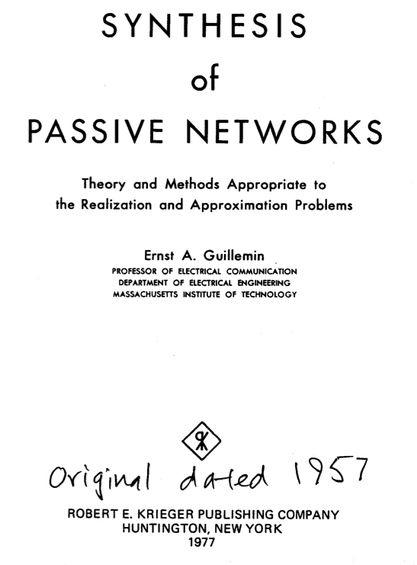

Foster’s theorem (1924)
Only a theorem for
lossless response!

Slide 45

Ernst Guillemin with Norbert Wiener

Slide 46



Slide 47

The solution to the problem of general, exact lossy synthesis came in this work:

Slide 48


Brune algorithm:
After “Foster preamble”:

Slide 49





Brune’s fixup:
Brune’s observation:
< 0 !
> 0
n $=\sqrt{\frac{L_{22}}{L_{11}}}$
> 0

Slide 50




Foster’s theorem, with loss

Slide 51



Slide 52




1966

Slide 53


Bernard D. H. Tellegen
Phillips Research

Slide 54




Slide 55




Slide 56



arXiv:1205.1910

Slide 57

χ=g²/Δ
s₁, s₂, s₃ are the states of the three qubits (0,1)
χ_{i} is dispersive shift parameter
Dispersive coupling is the same for each qubit
and the same on both resonators (a and b)

Slide 58



Wave impedance
“looking into” port A
(transmission line theory)
Reflection coefficient of full structure
NB
(Z₀=50Ω)

Slide 59

arg(r(ω)) for different qubit states
θ is the same for all even states (mod 2π)
θ is the same for all odd states (mod 2π)
θ_{even}≠θ_{odd}

Slide 60

Alternative solution of Mabuchi and coworkers

Slide 61


